Slide 1




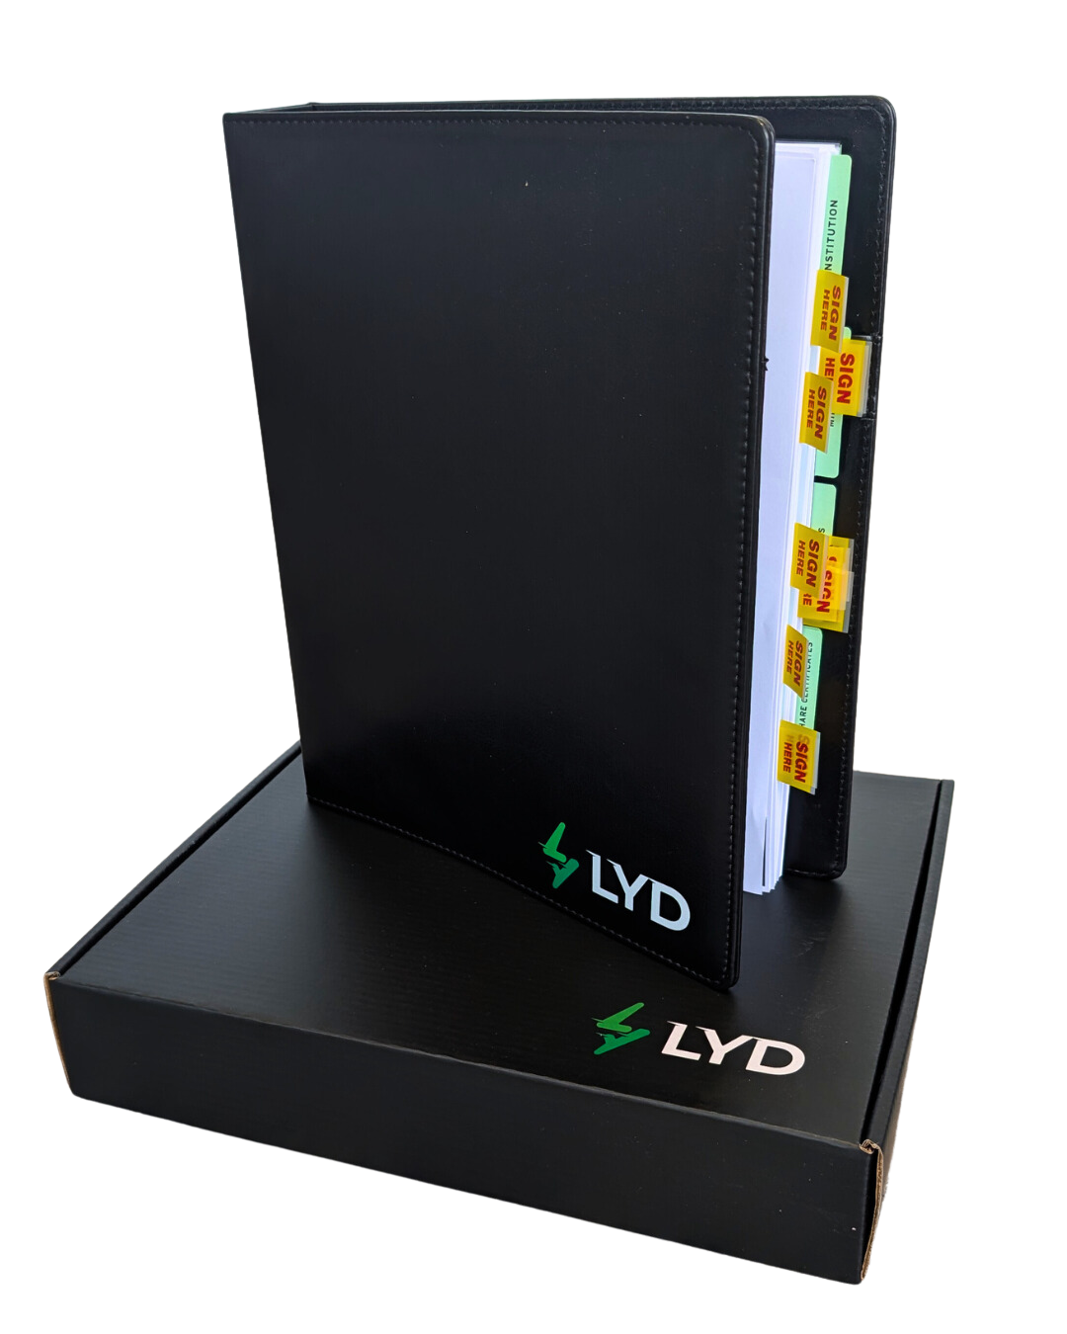


Slide 2

Succession Planning in 60 Minutes: Employee Share Plans, Selling Your Business, & Beyond
lyd.com.au

Slide 3

OUR PRESENTER – DR CRAIG WEST
A leading expert in business succession and exit planning.
Founder and Chairman of Succession Plus since 2009 – now the largest firm of its kind in Australia, with operations in the USA.
Holds a Doctor of Business Administration, Master of Tax Law, and Master of Business (Accounting & Finance).
His doctoral thesis focused on drivers of succession and successful exit strategies.
Named Exit Planner of the Year (2015, Exit Planning Institute Conference, Texas).
Inducted into the Circle of Excellence (2024, Exit Planning Institute).
Developed an award-winning Employee Ownership structure – ESOP of the Year twice in four years.
Author of six books on business valuation, succession, exit strategies, and employee ownership.
Serves as Non-Executive Chairman for several mid-market businesses, advising on ownership mindset and governance.
A sought-after keynote speaker, known for insights on succession, value gap assessment, and employee ownership.

Slide 4

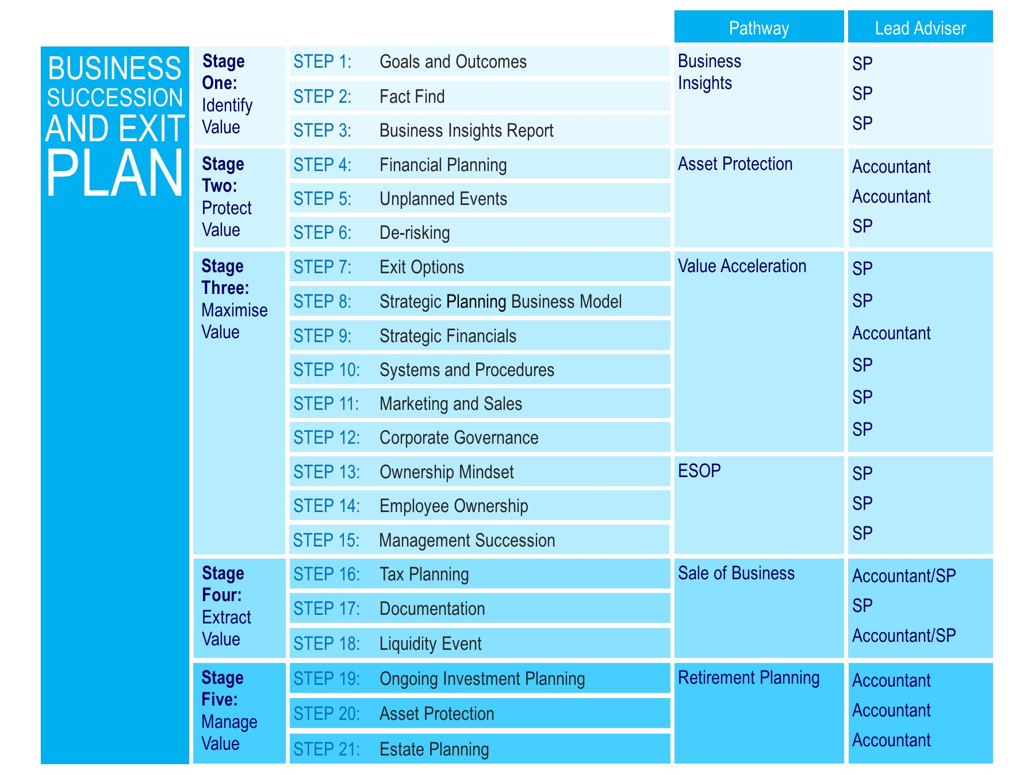
WEBINAR OBJECTIVES
& AGENDA
In this session, we’ll explore key stages of the Succession Plus 21-Step methodology, focusing on three critical phases:
Stage One: Identify Value
Stage Three: Maximise Value
Stage Four: Extract Value
lyd.com.au

Slide 5
STAGE ONE:
IDENTIFY VALUE
STAGE THREE:
MAXIMISE VALUE
STAGE FOUR:
EXTRACT VALUE
What is my business worth today?
Understand how to assess your current business value
Learn the key drivers that influence valuation
Use benchmarking and diagnostics to identify growth levers
What should/could my business be worth?
Explore strategies to accelerate business value
Align operations, people, and financials to boost valuation
How do I extract that value?
Examine exit options including Employee Share Plans (ESOPs)
Understand the mechanics of succession and sale
Plan for a smooth transition while preserving legacy
lyd.com.au

Slide 6


WHAT IS
SUCCESSION PLANNING?
Succession planning is a structured process to ensure the long-term sustainability, growth, and transition of a business – whether through sale, internal leadership development, or employee ownership.
A successful plan must consider three essential elements: the business itself, the owner/s, and the money. Understanding how these factors interact is critical to developing an effective strategy and achieving a smooth and successful exit.
lyd.com.au

Slide 7

KEY REASONS SMEs MUST PRIORITISE SUCCESSION PLANNING
Business Continuity: Keeps operations steady during leadership or ownership changes.
Value Protection: Preserves business value through planned transitions.
Exit Readiness: Aligns the business for sale or succession on the owner’s terms.
Confidence Building: Signals stability to employees, clients, and partners.
Growth Opportunities: Reveals ways to enhance systems, leadership, and profits.

Slide 8
STAGE ONE
IDENTIFY VALUE
The first stage in the Succession Plus 21-Step process is understanding the business’s current value – a critical foundation for planning the owner’s exit or succession.
lyd.com.au

Slide 9

KEY OBJECTIVES OF STAGE ONE – IDENTIFY VALUE
Stage One​ | Identify Value
Step 1: Goals and Outcomes
Step 2: Fact Find
Step 3: Business Insights Report
What are we trying to achieve ?
Begin with the end in mind
Establish a baseline valuation
Understand value drivers
Benchmark against industry peers
Set a strategic starting point

Slide 10
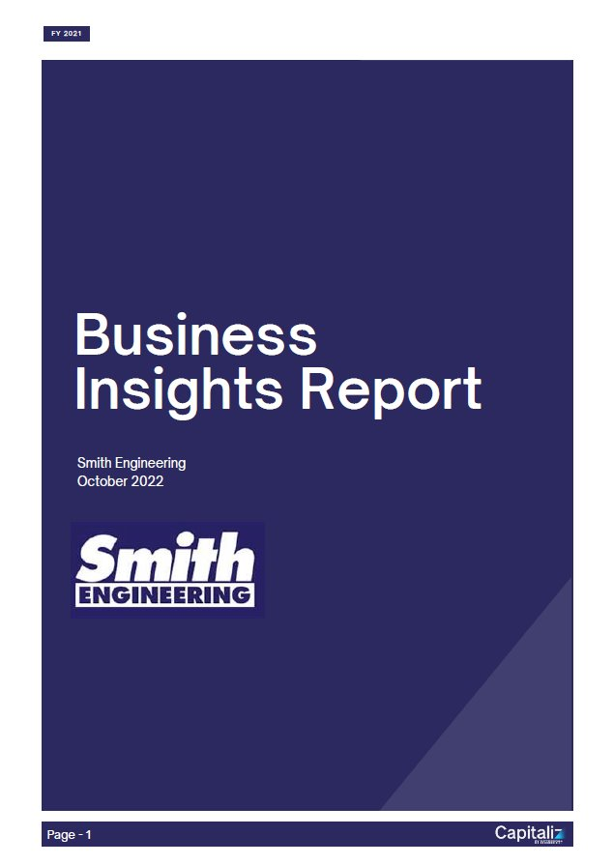
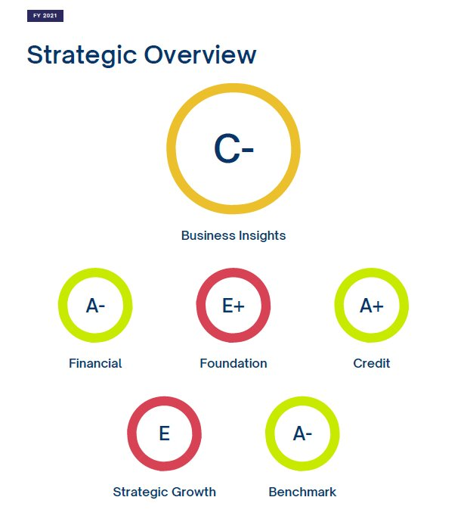
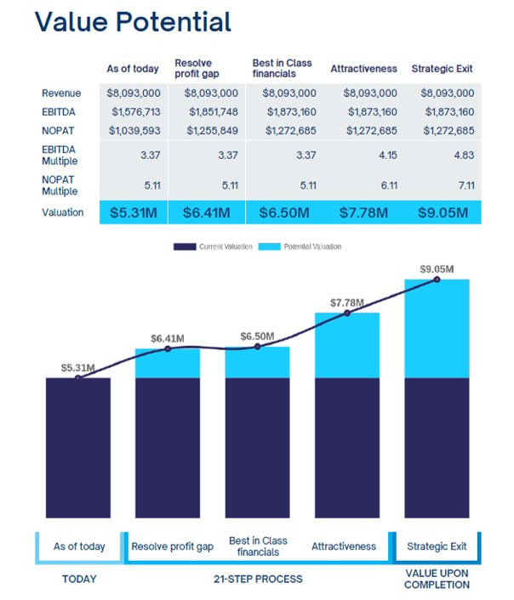
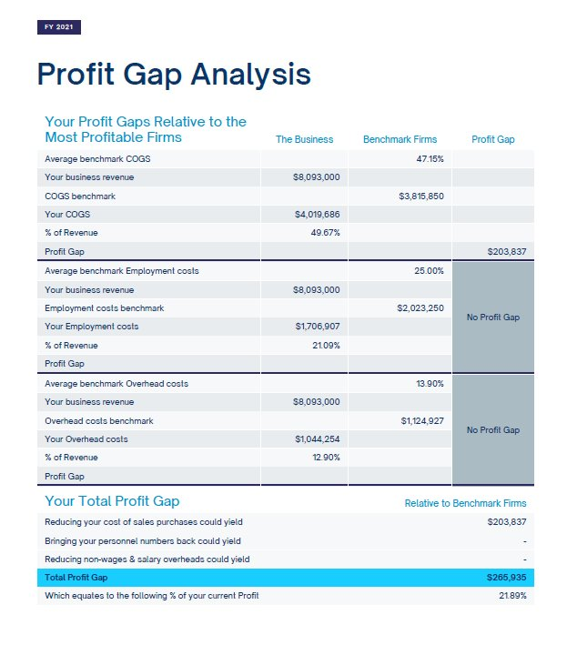
STEP 3 – BUSINESS INSIGHTS REPORT
Succession Plus leverages the Business Insights Report (BIR) to help business owners gain a clear understanding of their current position and identify opportunities to unlock future value.
What the Business Insights Report Provides
Comprehensive, Data-Driven Analysis
Evaluates the business across key value drivers using both financial and non-financial metrics.
Holistic Business Assessment
Covers areas such as financial performance, operational efficiency, leadership capability, systems maturity, and risk exposure.
Strategic Clarity
Offers a clear snapshot of where the business stands today – and highlights the potential for future growth and value creation.

Slide 11

STAGE THREE
MAXIMISE VALUE
Once the current business valuation has been established, the next step is to unlock its full potential. Stage Three focuses on accelerating value by enhancing performance, reducing risk, and aligning the business with clearly defined exit objectives.
lyd.com.au

Slide 12
KEY OBJECTIVES OF VALUE ACCELERATION
Close the Value Gap
Use insights from the Business Insights Report to target areas for improvement.
Enhance Key Value Drivers
Strengthen leadership, systems, profitability, and scalability.
Reduce Risk & Dependency
Minimise reliance on the owner and key individuals to make the business more transferable.
Align Strategy with Exit Goals
Ensure the business is structured and performing in a way that supports your ideal succession outcome.
Stage Three​ | Maximise Value​
Step 7: Exit Options​
Step 8: Strategic Planning Business Model​
Step 9: Strategic Financials​
Step 10: Systems and Procedures​
Step 11: Marketing and Sales​
Step 12: Corporate Governance​
Step 13: Ownership Mindset​
Step 14: Employee Ownership​
Step 15: Management Succession​

Slide 13
TURNING MINDSET INTO MECHANISM – THE ROLE OF EMPLOYEE OWNERSHIP
An Ownership Mindset is the cultural foundation.
Employee Ownership is the structural solution that brings it to life.
lyd.com.au

Slide 14

EMPLOYEE SHARE OWNERSHIP PLANS (ESOPS) -
A STRATEGIC TOOL FOR SUCCESSION
An ESOP is a structured plan that allows employees to acquire equity in the business they help build – turning mindset into ownership.
Attract, retain, motivate and reward key people.

Slide 15

STEP 14: EMPLOYEE OWNERSHIP
A formal mechanism for transferring shares to employees
Designed to align employee interests with business performance
Commonly used in succession planning, especially for SMEs
Supported by Australian tax and legal frameworks

Slide 16

START-UP ESOPs
Designed to align the interests of employees with those of business owners, providing significant tax advantages and fostering a sense of ownership among employees. ​
Restricted to businesses that meet certain conditions.​
Employer Eligibility
Not listed on public exchange
Aggregated turnover of less than $50m
Less than 10 years old
Australian resident taxpayer
Employee Eligibility
Less than 10% of shares (and voting rights)
Employed by holding company or subsidiary
Less than 15% discount
Hold for more than 3 years
75% of employees with more than 3 years service

Slide 17

THE PEAK PERFORMANCE TRUST
(A DEFERRED TAX PLAN)
A Peak Performance Trust or PPT is an employer-created ESOP trust into which contributions are made on behalf of, and for the benefit of, the company’s employees.
The company commits to investing an amount of money into the trust on a regular basis, contingent upon participating employees achieving predetermined performance outcomes (often profitability targets).
As the profits increase, so too does the contribution to the ESOP and the ability to purchase equity on the employer entity.
Under this plan, employees are not taxed at the time of receiving the shares. Instead, the tax is deferred until the shares become unrestricted.

Slide 18






SMITH ENGINEERING PEAK PERFORMANCE TRUST
CORPORATE
TRUSTEE
(Smith Engineering Nominees Pty Ltd)
SHAREHOLDERS
MR AND MRS SMITH
BUYS EQUITY
PEAK
PERFORMANCE
TRUST
PROFIT
SHARE
KEY
EMPLOYEES
Invited under rules set by company i.e., 12 months of service
EMPLOYER
SMITH ENGINEERING PTY LTD

Slide 19
ESOP
IMPLEMENTATION
ROADMAP
lyd.com.au

Slide 20
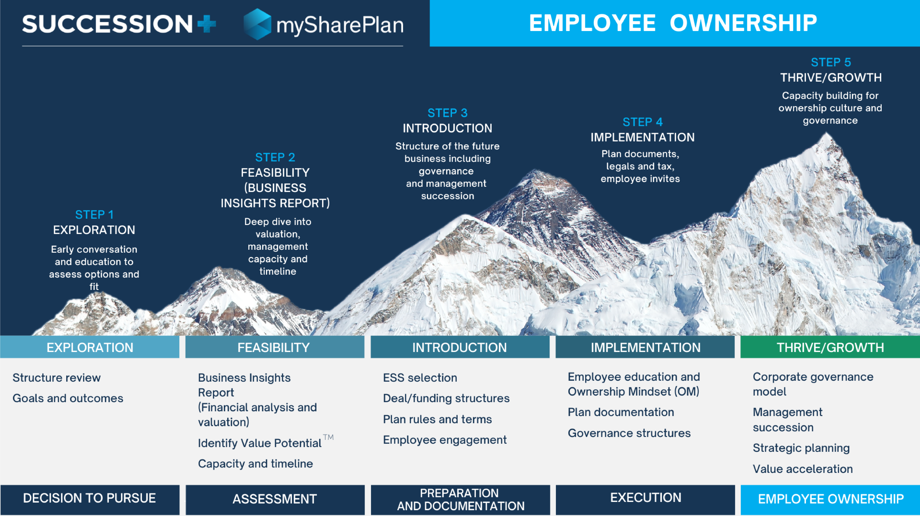

Slide 21
CASE STUDY
UMWELT – EMPOWERING GROWTH THROUGH EMPLOYEE OWNERSHIP
lyd.com.au

Slide 22
BACKGROUND
Umwelt, an environmental and social consultancy, embarked on a transformative journey by implementing an Employee Share Ownership Plan (ESOP). This strategic move aimed to align employee interests with long-term business success.
CHALLENGE
As the company expanded, maintaining a unified culture and strong employee engagement became increasingly important. Leadership sought a model that would foster accountability, collaboration, and a shared sense of purpose.
SOLUTION
The introduction of the ESOP enabled employees to become co-owners of the business. This shift cultivated a culture of ownership, where team members were empowered to think and act in the best interest of the company.

Slide 23
IMPACT
Managing Director Barbara Crossley noted,
    “It’s fantastic to see employment ownership and participation in the ESOP increase as we continue to grow and evolve the business. As we work through opportunities and challenges, we see our team work together with a ‘best for business’ approach, and strong commitment to delivering for our clients and achieving our business goals. I am so very pleased to see our employees have the opportunity to share in our success, through the ESOP.”
An employee echoed this sentiment:
    “I think fundamentally for me, it makes me feel like I'm effectively an owner of the organisation and the actions I undertake day-to-day have broader ramifications for the company's success.”

Slide 24
KEY FIGURES
Over 700% increase in share value
47.34% of Umwelt is now employee-owned
126 current employees own 47,344 units
Participation growth: from 40 employees in 2017 to over 120 by 2025
RESULTS
Significant wealth creation for employees
Stronger alignment between individual contributions and business outcomes
Enhanced team cohesion and commitment to client delivery
Elevated market positioning as an employee-owned environmental sciences operator.
CONCLUSION
Umwelt’s ESOP journey demonstrates how employee ownership can drive engagement, accountability, and sustainable growth. For businesses considering an ESOP, this case illustrates the tangible benefits of fostering a dedicated, invested workforce.

Slide 25
SUCCESSION PLUS ESOP SNAPSHOT
161
1,829
PLANS
EMPLOYEES
12.23m+
$89.07m+
SHARES
IN VALUE

Slide 26
REVIEWING EXIT OPTIONS
Every exit path has different outcomes. Consider your goals, timeline, and level of involvement.
Family or Friends – Pass the business to someone you trust.
Sell to Database Only – Quiet, targeted sale to known contacts.
Sell to Other Shareholders – Transfer ownership within the existing group.
Partial Sale – Release some equity, stay involved.
Employee Share Plan (ESOP) – Gradual internal transfer to staff.
Internal Sale/MBO – Sell to the management team.
Trade Sale – Sell to a company in your industry.
Private Equity/Venture Capital – Attract growth capital and expertise.
Strategic/Listed Sale – Sell to a public or larger company.
IPO (Initial Public Offering) – Float shares on the stock exchange.

Slide 27
STAGE FOUR:
EXTRACT VALUE
This stage is about extracting the full value of years of effort and embedding that value into a sustainable, sale-ready business.
lyd.com.au

Slide 28


EXTRACTING VALUE – PREPARING FOR SALE
Stage Four | Extract Value
Step 16: Tax Planning
Step 17: Documentation
Step 18: Liquidity Event
This stage focuses on converting the business’s built-up value into a tangible outcome for the owner.
It involves preparing the business for sale or transition in a way that maximises return, minimises risk, and ensures continuity.

Slide 29

STEP 16 – TAX PLANNING
Maximising net proceeds by minimising tax liabilities:
Leverage small business CGT concessions.
Review ownership structures to optimise outcomes before and after the sale.
Account for legal, accounting, and other transaction-related costs.

Slide 30
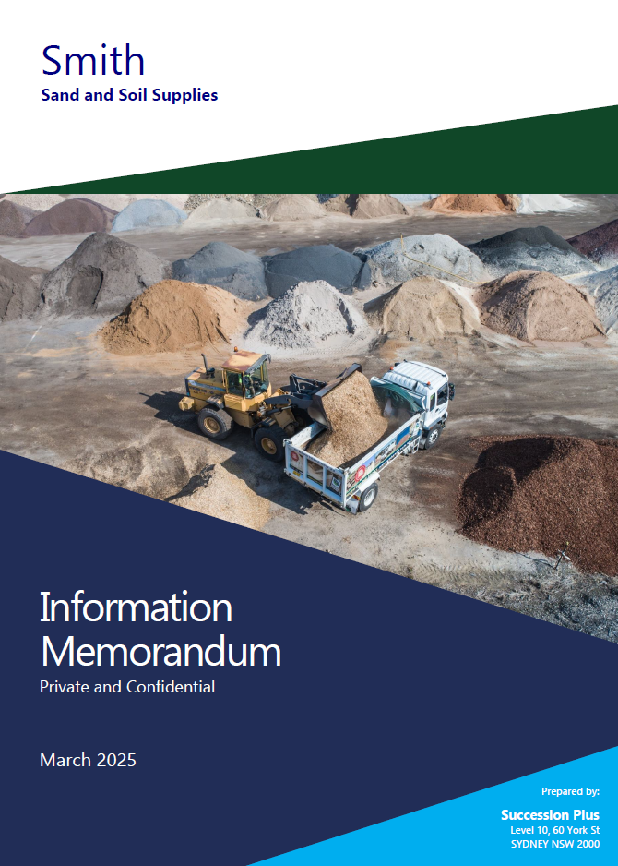
STEP 17 – DOCUMENTATION
Information Memorandum (IM)
Precision and preparation are essential when preparing a business for sale. The IM serves as the business’s sales brochure and should clearly communicate:
What the business does and why it holds value
Historical financial performance and future projections
Key personnel, customer relationships, systems, and intellectual property
Identified risks and how they are managed
The reason for the sale and the opportunity it presents to potential buyers
💡 Tip: A well-prepared IM anticipates and answers buyer questions before they are asked.

Slide 31

Due Diligence Readiness
MOST DEALS COLLAPSE DURING
DUE DILIGENCE.
Buyers will scrutinise every detail, so the business must be ready with:
Clean, current financial records
Up-to-date employment and supplier contracts
Tax filings, IP registrations, and lease agreements
Documented policies and procedures
✅ A due diligence checklist helps minimise delays and avoid surprises.

Slide 32
COMMON PITFALLS TO AVOID
Overestimating value: Leads to stalled deals
Poor financial records: Red flags for buyers
Unclear ownership of IP or assets
Key-person risk: If the business relies too much on you
Rushing to market unprepared
📈 Preparation takes time… but it protects price and ensures a smoother exit.

Slide 33

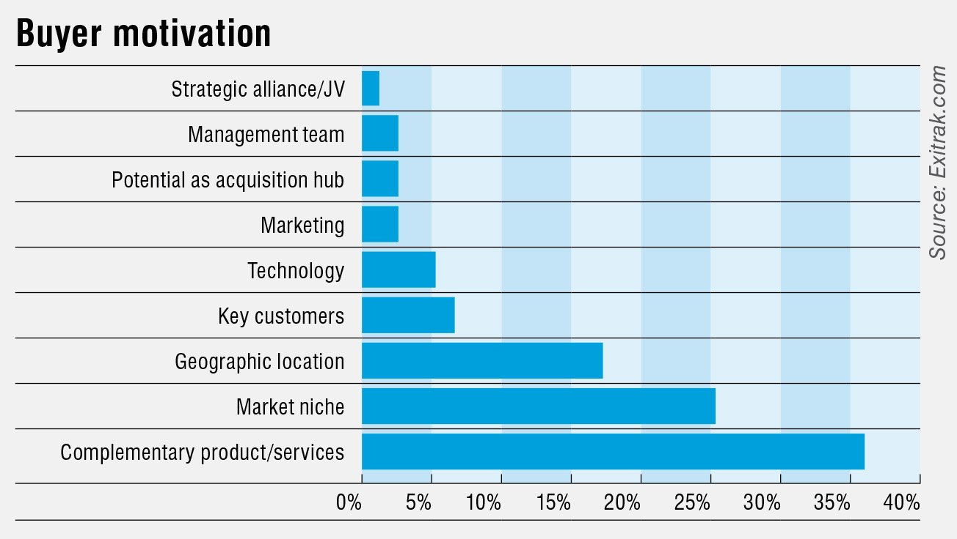
STEP 18 – LIQUIDITY EVENT
Execute the actual transition – Whether through a third-party sale, management buyout, or ESOP. The focus is on achieving the best outcome for the owner while preserving the business’s legacy and momentum.
Strategic Value Drivers

Slide 34
SUCCESSION PLANNING
IS A TEAM EFFORT.
No one adviser can do it all – and that’s the point.
lyd.com.au

Slide 35

A COLLABORATIVE APPROACH
TO SUCCESSION PLANNING
Effective succession planning isn’t a solo effort – it’s a coordinated strategy.
The Succession Plus 21-Step Framework outlines the key stages of a successful plan and clearly defines who is responsible for each step.
Succession Plus acts as the Lead Adviser, managing the overall strategy and implementation.
Accountants play a vital role in financial modelling, tax structuring, and compliance.
Defined roles ensure accountability, reduce duplication, and keep the process on track.
By working together, we deliver better outcomes for business owners – and unlock new advisory opportunities for your firm.

Slide 36
THE COLLABORATIVE SUCCESSION PLANNING FRAMEWORK

Slide 37
WHY PARTNERING MATTERS
Succession planning is most effective when it’s collaborative – and that includes the advisers behind the scenes.
The 21-step framework clearly defines roles:
  Succession Plus leads the strategy and implementation
  Accountants bring critical expertise in financials, tax, and compliance
But collaboration doesn’t happen by accident – it happens by design.

Slide 38
INTRODUCING THE
LYD + SUCCESSION PLUS PARTNERSHIP:
WE SUCCESSION
lyd.com.au

Slide 39

LYD + SUCCESSION PLUS PARTNERSHIP MODEL
Succession planning works best when advisers work together — and that’s exactly what this partnership is built on.
The Collaborative Succession Planning Framework shows that no single adviser can deliver a complete solution alone.
That’s why LightYear Docs and Succession Plus have partnered to create We Succession – a program designed to empower accountants to deliver succession planning services with confidence, structure, and support.

Slide 40
ABOUT WE SUCCESSION (POWERED BY SUCCESSION PLUS)
An exclusive offer for LYD Partners that combines expert strategy, proven tools, and a shared-value model.
Partner Benefits
Exclusive discounts for you and your clients
Fee split model to create a new revenue stream
Access to industry-leading tools and ongoing support
Co-delivery model – work alongside Succession Plus on client projects

Slide 41
OUR SOLUTIONS
✔ Value Gap Assessment (VGA) Tool
The perfect conversation starter – helps clients understand what their business is worth and why. Includes unlimited reports.
✔ Business Insights Report (BIR)
A comprehensive 60-page report with valuation, benchmarking, and a 21-step implementation plan to maximise value and prepare for exit.
✔ Employee Share Ownership Plans (ESOPs)
Designed to retain and motivate key people while supporting succession and continuity.
✔ Business Brokerage & M&A Support
Expert guidance through business sales, mergers, and acquisitions — from preparation to negotiation.

Slide 42
PARTNER PRICING & FEE SPLIT
Product | Standard Price | LYD Partner Price | Discount | Fee Split to Your Firm
Value Gap Assessment (VGA) Tool | $500/month | $450/month | $50/month | –
BIR | $9,000/report | $8,000/report | $1,000 | $2,000
Peak Performance Trust | $20,000/plan | $18,000/plan | $2,000 | $2,000
ESOP (Start-up) | $8,000/plan | $7,500/plan | $500 | $500
M&A Support | $5,000/month + 5% success fee | Same | –

Slide 43
WHAT IS THE
VALUE GAP
ASSESSMENT TOOL?
lyd.com.au

Slide 44
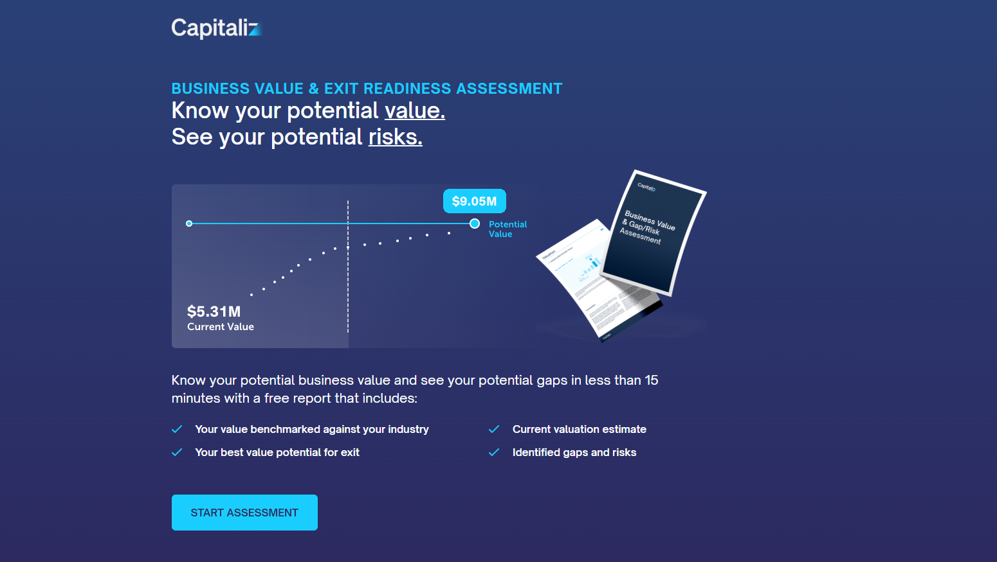


Slide 45
ADVISER ENABLEMENT: STRATEGIES, FAQS & NEXT STEPS
lyd.com.au

Slide 46
NEXT STEPS AND CALL TO ACTION
What to Do Now
Sign up for the We Succession program today.
Schedule a demo of the VGA Tool.
Contact Michael Jeffriess (LYD) or Craig West (SP) for support or assistance.
  Michael Jeffriess | michael@lyd.com.au | 1300 168 380
  Craig West | cwest@succession.plus | 0418 414 766

Slide 47
THANK YOU FOR JOINING US!
We look forward to collaborating with you!
lyd.com.au

