Slide 1

Five Waves, One Lifeboat
How We Protect Wealth, Families and the Future — Together

Slide 2

A Storm Unlike Any Other
Five historic forces are converging simultaneously. Individually, each could destabilize the economy. Together, they create a storm no adviser, no SMSF member, and no family can face alone.
We survive this the same way sailors survive rough seas — in a lifeboat, rowing together, with shared tools, shared intelligence, and shared structures. Collaboration is no longer optional; it is the strategy that will protect Australian families for the next decade.

Slide 3

Meet Grant Abbott
Australia's Leading Voice in Family Wealth Protection
For over three decades, Grant Abbott has stood at the forefront of every major evolution in the SMSF and wealth-protection landscape — shaping policy, educating the profession, building structures, and protecting families.
Chairman of SAPEPAA, co-founder of LightYear Training Group, and architect of Australia's most comprehensive family wealth structures.

Slide 4
Grant's Unmatched Expertise
3,000+ Presentations
100,000+ Advisers Trained
Keynote addresses shaping the industry
Building professional capability nationwide
9 Books Authored
Trillion-Dollar Impact
Foundational strategies for the profession
Helped build SMSF cornerstone of retirement wealth

Slide 5




Grant's Core Capabilities
Legislative Mastery
Structural Defense
Decodes legislation into actionable strategy with precision
Exposes weakness before damage occurs
Integration Expert
Cycle Anticipation
Integrates tax, legal and wealth flows into coherent family models
Anticipates cycles years ahead of the market

Slide 6

Grant's Mission
To protect Australian families from the Five Waves coming in 2026–2030, and to build a new generation of advisers capable of guiding those families safely forward.

Slide 7
Grant's Core Beliefs
Wealth must be protected, not merely earned
Family governance is as important as tax strategy
SMSFs are the engine of intergenerational legacy
Trusts must evolve to Family Protection Trusts
Advisers must evolve into strategists
Collaboration is the only way to survive what is coming

Slide 8

The Brutal Truth
Australia is walking into the most dangerous five-year period in 70 years, and most people have absolutely no idea. The signs were visible years ago — but in 2026 they collide at the same time.

Slide 9





The Five Waves
Property Cycle End
Global real estate valuation reset 2026-2028
AI Workforce Shock
30-50% of white-collar tasks automated by 2031
China Engine Collapse
Property boom over, iron ore demand shifting
NDIS + Boomer Tsunami
$100B NDIS + 1.2M Boomers over 80
Intergenerational Tax
Inheritance and wealth taxes inevitable

Slide 10
Wave 1: The Property Cycle End
Phil Anderson's cycle. Fred Harrison's cycle. 230 years of data. This one always ends the same way. Australia, the US, and the UK are at the end of the 18.6-year real estate cycle.
1880s-1890s
1
Depression
2
1920
Severe depression
1973
3
Oil shock collapse
4
1989-1990s
Market crash
2007-2008
5
GFC
6
2026-2028
Next cycle peak

Slide 11
Where We Are Now (2026)
Valuation Peak
Commercial Crisis
Australian residential valuations most expensive in the world relative to income
Office market in silent crisis with 40-70% falls in the US
SMSF Risk
Margin Excess
Direct property holdings face serious liquidity crunch
Global equity margin debt at GFC-level excess

Slide 12

2008 vs 2026: The Critical Difference
2008 Market Impact
2026 Reality
Bitcoin: -95%
Nobody is coming to save us this time.
Global equities: -55%
Australian property: -8% nominal, -20% real
This is the first wave — and it arrives without a safety net.
Commercial property: -30-40%
But China saved us.

Slide 13
Wave 2: AI Workforce Devastation
If you think AI is today's "crypto hype", you haven't been paying attention. By 2029-2031, we face the largest workforce displacement since the Industrial Revolution — compressed into five years, not fifty.
30-50%
20x
10-12%
Tasks Automated
Productivity Multiplier
Peak Unemployment
White-collar labour tasks by 2031
Single AI worker output equivalent
Conservative projection if adoption accelerates

Slide 14
Australia's AI Vulnerability
Australia's labour market is heavily concentrated in sectors AI attacks first: professional services, finance, admin, government, education, and healthcare administration.
Income Tax Collapse
Australia relies on income tax far more heavily than other OECD members
Corporate Polarization
AI-enabled firms explode; labour-heavy firms die
Wage Suppression
AI caps wage increases for white-collar professionals
Consumption Drop
People earn less but still pay more for essentials
Inequality Explosion
AI winners get extremely rich; everyone else stagnates

Slide 15




Wave 3: China No Longer Saves Australia
In 2008-2012, China's massive stimulus kept Australia out of recession. That world is gone. China's property collapse is now structural, not cyclical.
25% of Chinese GDP was property-related — developers have collapsed
Population decline accelerates with new apartments sitting empty
Beijing has accepted lower growth as the new norm

Slide 16



The Simandou Threat
China is directly financing, owning, and building the Simandou iron ore mega-development in Guinea. Production expected 2025-2026. Capacity: 200+ million tonnes annually — a direct competitor to the Pilbara.
Lower Prices
Employment Hit
Budget Crisis
Iron ore prices fall, reducing tax revenue
Mining boom employment reduced
WA royalties hit, deficits widen

Slide 17
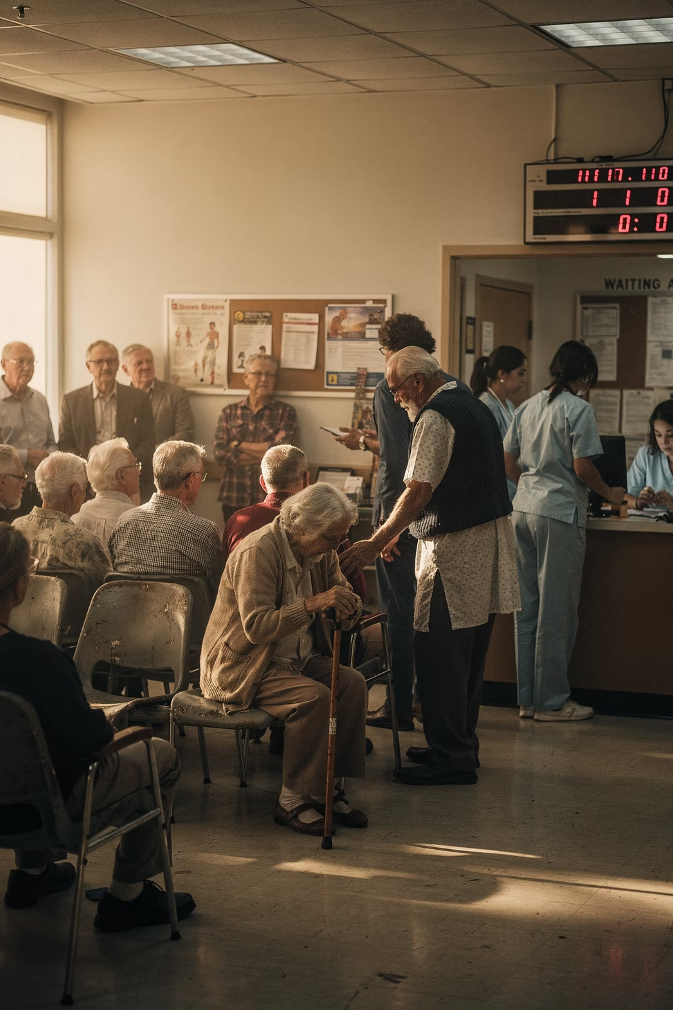
Wave 4: The Fiscal Tsunami
NDIS + Ageing Boomers
This is the wave few Australians understand — but Treasury understands it all too well. NDIS is now larger than Medicare, growing faster than forecast, projected to hit $100 billion annually within 8-10 years.

Slide 18





The NDIS Cost Explosion
Fraud & Over-Servicing
Provider Price Inflation
Administrative Bloat
Autism Diagnoses Escalating
Political Impossibility of Reform
NDIS will become the single largest welfare program in Australian history.

Slide 19



The Boomer Problem
5.5M
1.2M
30-40%
Total Boomers
Over 80 by 2030
Capacity Shortage
Born 1946-1964
Hitting critical age
Aged care demand exceeds supply
By 2030, retirement savings will be exhausted for the bottom 60% of Boomers. Age pension demand surges. Health system costs explode as end-of-life care becomes the most expensive component.

Slide 20










The Perfect Fiscal Storm
Boomers Age
Boomers Retire
Health costs rise
Tax receipts fall
NDIS Rises
Spending blows out
China Slows
Company tax falls
Property Falls
Stamp duty collapses

Slide 21

Wave 5: Intergenerational Transfer Tax
Treasury is already softening the public for this. It is coming. Division 296 is the first step — not the last.
Why? Because Boomers hold $4 trillion in property, Australia faces decades of deficits, the tax base is shrinking, and NDIS + aged care + pensions cannot be funded.

Slide 22
The UK Model: Australia's Template
UK Inheritance Tax
UK Mansion Tax
40% on estates above £325,000 (about AUD $615,000)
Proposed 1% annual wealth tax on high-value residential property
Home ownership taxed
Business assets taxed
Targets properties > £2 million
Family wealth taxed
Greece, Ireland, UK, Canada already use inheritance or wealth taxes. Australia will join them.

Slide 23
The Five Waves: Summary
Wave
Summary
Impact
Property Cycle End
2026-2028 major downturn
Home values, SMSF property, equities all hit
AI Workforce Shock
10-12% unemployment plausible
Income tax collapse, inequality, contraction
China Backstop Gone
Property boom over + Simandou
Falling company tax, AUD risk, WA recession
NDIS + Boomers
$100B NDIS + 1.2M over 80
Budget crisis, pension blowout, aged care shortage
Intergenerational Tax
IHT/Wealth tax inevitable
Families unprepared, estates at risk

Slide 24

The Strategies
Ten core strategies plus bonus strategies to navigate the Five Waves and protect Australian families for the next decade.

Slide 25




Strategy 1: Become an AI-Augmented Adviser
AI is not replacing advisers. AI is replacing bad advisers — the ones who rely on memory, slow thinking, guesswork, or outdated methods. Practitioners who combine human strategy with AI tools become super-advisers.
Strategist AI
Tax Guru AI
Maps structures and risks instantly
Calculates consequences with legislative precision
Gamma AI
Five Step AI Tool
Builds client presentations visually
Shows governance pathways

Slide 26



The New Adviser Hierarchy
AI-Augmented Strategist
1
The new elite who survive
Hybrid Adviser
2
Transitional, vulnerable
Legacy Adviser
3
Will lose 40-60% of clients by 2030
"AI won't take your job — but the adviser who uses AI well will take everyone else's clients." — Grant Abbott

Slide 27
The AI-Augmented Adviser in Practice
01
02
Strategy Session
Tax Modelling
Input client facts → AI produces structure map, risk map, succession map, tax consequences, compliance issues, strategy options in 40 seconds
Tax Guru answers CGT, Division 296, contributions, LRBA effects, trust distributions, NALI/NALC traps with legislative references
03
04
Client Impact
Family Governance
Gamma creates diagrams, timelines, charts, infographics that make clients say "NOW I get it"
Five Step AI Tool develops vision, values, roles, structures, succession

Slide 28

Strategy 2: Transform the Client Meeting
The traditional client meeting is gone. The future belongs to the adviser who can deliver clarity, certainty, structure, and strategy in real time, right in front of the client.
AI will decimate 80% of planning tasks, 70% of accounting tasks, and 60% of tax analysis within five years. The ATO is about to gain one million AI auditors performing real-time monitoring across every taxpayer.

Slide 29


The New Client Meeting Experience
Visualize With Gamma
Deep-Dive With Tax Guru
Turn strategy into diagrams, charts, timelines, explainer slides — a client-ready brochure
Open Strategist AI
Answer Division 296, SMSF, CGT, contribution questions live with legislation references and calculations
Gather facts in conversation. As client speaks, type bullet points. AI produces structure map, risk assessment, succession analysis instantly
Clients watch their life, wealth and risk profile come alive on screen. Their trust becomes instinctive. Their engagement becomes emotional. Their decision-making becomes immediate.

Slide 30

Strategy 3: Join SAPEPAA
No adviser can survive the Five Waves alone. You cannot read every ruling, model every scenario, update every skill, build every structure, or navigate every family governance issue without support.
"The future belongs to communities, not individuals. If you row alone, you drown alone." — Grant Abbott

Slide 31



What SAPEPAA Is
SAPEPAA is the only professional body in Australia built specifically for succession, asset protection, estate planning, family governance, intergenerational strategy, SMSF estate mastery, and modern structure design.
Protection Focus
The Lifeboat
Five Waves Ready
Teaching advisers how to protect families from the tax system, legal system, courts, and government revenue grabs
For advisers who want to stay relevant, profitable, indispensable, and ahead of AI
The only association preparing advisers for what's coming

Slide 32
SAPEPAA Accreditation Pathways
SAPEP Accreditation
1
Foundation training in family risk diagnosis, asset protection systems, succession pathways, trust structuring, SMSF Wills, and AI intelligence
Board of Guardians
2
Advanced strategist evolution: vision setting, governance planning, family leadership, wealth stewardship, intergenerational continuity
You don't simply advise families — you lead them. You become the guardian of their wealth and legacy.

Slide 33

Strategy 4: Upgrade to Family Protection Trusts
Every Trust Must Evolve
Australia has more than one million discretionary trusts. Most are old, poorly drafted, asset-exposed, appointor-unstable, successor-uncertain, and litigation-vulnerable. These trusts were never designed for intergenerational warfare, blended families, Caldwell, digital assets, or modern family provision litigation.

Slide 34
Caldwell: The Case That Changed Everything
In 2023-2024, Caldwell exposed the greatest weakness in Australian trust law: Control is everything. And most families do not actually control their trusts.
1
2
3
Appointor Control
Successor Provisions
Beneficiary Infiltration
Appointors are true controllers — unclear provisions invite court intervention
Must be precise, not implied — old deeds fail on incapacity, death, divorce
Disgruntled beneficiaries can gain control through litigation
4
5
No Bloodline Protection
Family Law Risk
Spouses and ex-spouses can gain influence or benefit
Courts increasingly treat trusts as "resources"

Slide 35
Five Reasons for Immediate FPT Upgrade
1. Bloodline Protection
2. Successor Control
3. Creditor Protection
Keep assets in family, not with in-laws, ex-spouses, or opportunistic litigants
Stop litigation with defined bloodline successor rules and incapacity triggers
Purpose-built to withstand bankruptcy, business failure, and creditor claims
4. Estate Defense
5. Modern Compliance
Prevent family provision attacks and estate inclusion
Written for modern trust law, ATO guidance, and AI-driven audit environments

Slide 36
Strategy 5: Division 296 Modelling + FPT Rollout
Division 296 is not a tax — it is a signal from Treasury that superannuation is no longer a sacred tax shelter, large balances are revenue targets, and intergenerational wealth in super will be restricted.
$3M
200K+
15%
TSB Threshold
SMSFs Affected
Additional Tax
Total superannuation balance trigger
Will face this question directly
On earnings above threshold

Slide 37

The Power of Live Modelling
With the Division 296 Calculator, show clients their estimated annual liability, difference between leaving wealth in super vs withdrawing, projected liability over 10-20 years, tax outcomes in pension phase, and how structure migration changes the long-term position.
"When clients SEE the numbers, the decision becomes obvious."

Slide 38
The FPT Rollout Strategy
Rolling wealth out of super into an FPT may reduce long-term Division 296 exposure, provide flexible investment structures, prevent estate litigation, harden asset protection, and create intergenerational governance frameworks.
Super Environment
Strategic Migration
FPT Environment
Division 296 taxed, restricted flexibility
Planned withdrawal and rollout
Protected, flexible, tax-efficient
For some families, super is no longer the BEST place to store retirement wealth.

Slide 39

Strategy 6: Build Elite Capability Through LightYear
For the last decade, training has been dying: endless webinars, slide decks read aloud, theory without application, CPD box-ticking. The world is too complex for this. AI is too fast for this. The Five Waves are too severe for this.
LightYear Training Group (LYTG) is not delivering "education" — it is delivering elite strategist capability.

Slide 40




The LYTG Method
Real Case Studies
AI Integration
High-stakes family and SMSF cases, not hypothetical scenarios
Strategies created live using Strategist AI, Tax Guru, Gamma, Five Step Tool
Collaborative Problem Solving
Immediate Implementation
Teams solve cases together, learning structure options and risk identification
Use strategies with clients the same week

Slide 41
Five Capabilities LYTG Builds
01
02
03
Strategic Thinking
AI-Augmented Problem Solving
Case-Based Reasoning
Think like lawyers, tax specialists, estate strategists, asset protection architects as an integrated strategist
Use AI as co-strategist, modelling engine, legislative assistant, tax calculator
Confidence from solving dozens of high-level cases
04
05
Structure Mastery
Communication Impact
Design FPTs, SMSF Wills, bloodline clauses, succession pathways
Storytelling, visual explanation, meeting choreography, objection handling

Slide 42

Strategy 7: Build Your Professional Team
The single biggest mistake advisers make is believing "I can handle this myself." This mindset is fatal in a world where legislation shifts monthly, structures collapse under litigation, and AI accelerates complexity.
"A single adviser cannot protect a family from a system designed to dismantle wealth. A strategic team can." — Grant Abbott

Slide 43





Legal Back Office + LY Legal
Direct Mentoring
LY Legal Access
Team Strategy Design
Access Grant's 30+ years of structuring intelligence and case law insight
Reviews, drafts, structures, documents, rectifies, protects
Collaborate on strategy, family mapping, risk assessment, structure modelling
Quality Control
Capability Scaling
Strategies validated, documents reviewed, risk shared, advice strengthened
Capacity multiplies, handle bigger cases, service more families

Slide 44

Strategy 8: Family Wealth Protection Structure
The Aircraft Carrier
Family Wealth Protection is the integrated system that removes wealth from personal risk, transfers it into protected structures, defends it from taxation, shields it from litigation, ensures it stays in the bloodline, and creates governance for future generations.

Slide 45






The Three Essential Components
SMSF Will
Directs super to FPT, avoids death benefit tax, prevents trustee hijacking, protects blended families
Family Protection Trust
The permanent wealth vault — litigation, spouse, creditor, tax, and blended-family resistant
Protector Strategy
Strips wealth safely without CGT or stamp duty — secured creditor position
Together they form the only structure in Australia that can withstand all Five Waves.

Slide 46
The Protector: Wealth Transfer Without Tax
We do NOT transfer the property into the trust. That causes duty and CGT. We transfer the wealth, not the asset.
Gift
Loan-Back
Result
Cash or promissory note
Secured mortgage/PPSR
Zero personal equity, complete protection
Legal title remains with family, equity stripped cleanly, FPT becomes secured creditor. No CGT, no stamp duty, no notional estate (except NSW within 3 years), no family law claims, no creditor reach, no wealth tax inclusion.
"We never transfer the asset — we transfer the wealth inside it." — Grant Abbott

Slide 47
Strategy 9: Position SMSFs for the Property Cycle
We are at the edge of the speculative peak of the 18.6-year land cycle. The pattern is always the same: boom, mania, tightening, crash, clearance, recovery, new era. Right now we're in late mania, with the crash-window opening 2026-2028.
Crash Phase
Accumulation Phase
2026-2028: Survive & defend with liquidity
2030-2033: Build generational wealth
1
2
3
Clearance Phase
2028-2030: Opportunity window opens

Slide 48










Strategy 10: Build the AI-Augmented Family Office
The future adviser sits at the centre of a family's long-term wealth, governance, protection, and legacy. This is the AI-Augmented Family Office, powered by Strategist AI, Tax Guru, Gamma, Five Step AI Tool, SAPEPAA methodologies, and integrated structures.
FPT Structure
AI Strategy Engine
Family Governance
Long-Term Stewardship
Interdisciplinary Team
You become the protector, strategist, architect, navigator, and lead adviser for families through the Five Waves and the next 50 years.

Slide 49







Grant Abbott's Brands
Each brand represents a pillar of the comprehensive family wealth protection ecosystem Grant has built over three decades.

Slide 50

Row Together, Survive Together
"Five historic forces are converging all at once. Together, they create a storm no adviser, no SMSF member, and no family can face alone. We get through this the same way sailors survive rough seas — in a lifeboat, rowing together, with shared tools, shared intelligence, and shared structures."
— Grant Abbott
Collaboration is no longer optional — it is the strategy that will protect Australian families for the next decade.

