Slide 1
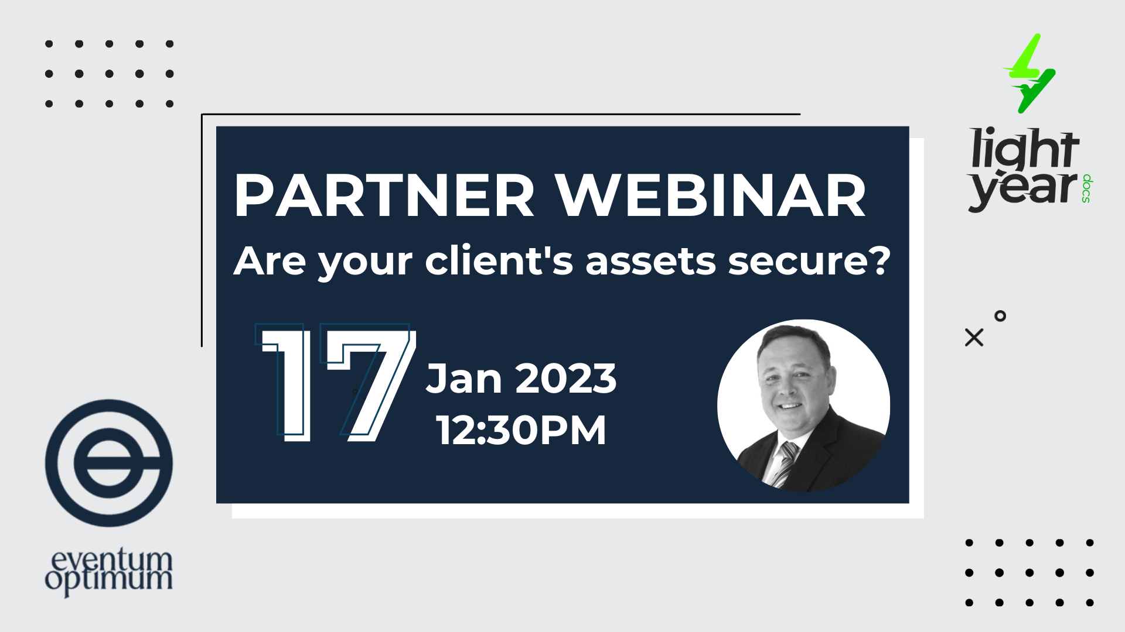
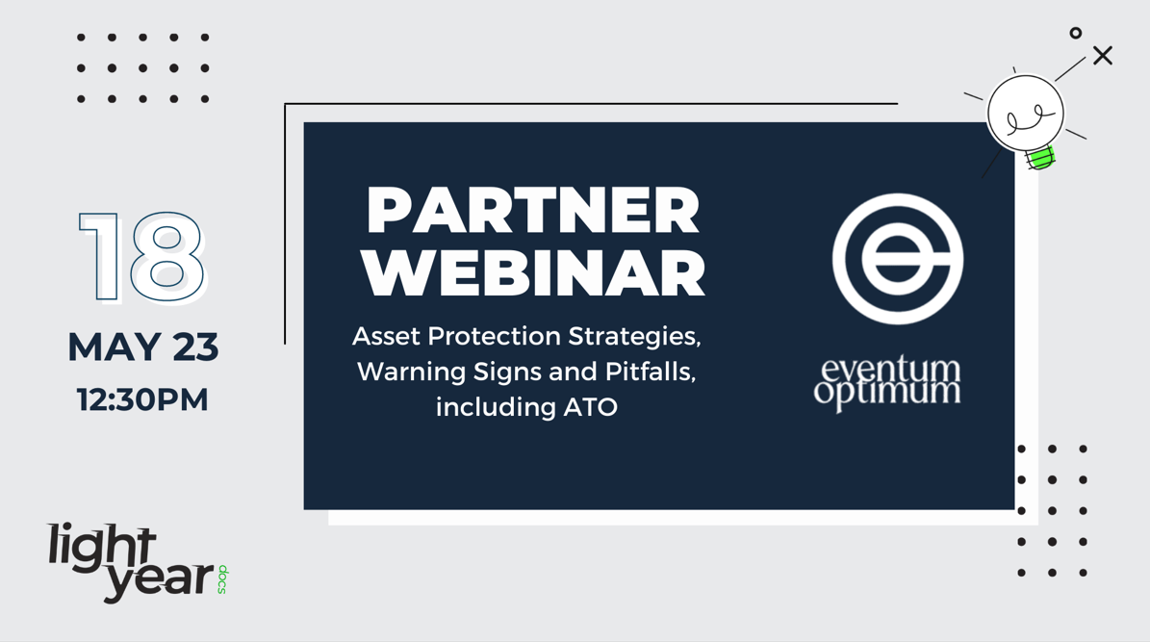



Slide 2




Today’s Session
Eventum Optimum x LightYear Docs
Asset protection strategies
Economic conditions - interest rates and bad debts
ATO - current actions and what to do
DPN’s - credit bureau warnings from ATO
Div 7A Loans
Q&A
Call to Action

Slide 3




Asset Protection Strategies
Personal asset protection
Business asset protection
PPSR’s
Mortgages
ng assets protects your clients

Slide 4

Facts
Corporate structures
Choose directorships with asset protection in mind
Avoid unnecessary directorships
Avoid unnecessary PG’s
Avoid related party loan accounts
Avoid tax grouping
Separate personal assets from company assets

Slide 5

Economic Conditions interest rates & bad debts
Supply side issues – labor and materials
Macro events
War in Ukraine
Food shortages
Inflationary pressures
Interest rate rises
Post Covid climate
Construction sector – “the profitless boom”
Bad debts – domino effect

Slide 6
ATO Collections Actions And What To Do
Early Warning DPN’s
Credit bureau notifications
Debtor/creditor notifications
Garnishee orders
Statement of claim
Creditor statutory demands

Slide 7

What is a DPN?
The ATO rolled up the sleeves in 2022, ending its debt recovery hiatus by issuing a claimed 50,000 Director Penalty Notice (DPN) warning letters and almost 18,500 actual DPNs….and the ATO has flagged firmer action to recover unpaid debt.
If the DPN liability is not paid or cannot be avoided, the ATO can pursue directors personally for the DPN debt owed. This can involve:
  Issuing a notice to garnishee assets or income
  Withholding taxation refunds to offset/reduce the debt owed
  Reporting defaults to credit reporting agencies, which may adversely impact your client’s credit rating and limit their ability to borrow money
  Pursuing legal proceedings to bankrupt the director
Assets at risk can include bank accounts, cryptocurrency, vehicles, shares, property and even interests in deceased estates. The director’s share of jointly owned assets is also at risk!
There is no time limit on the ATO pursuing debts owed (unlike most other debts where time limits apply)

Slide 8
Div 7A Loans
A Division 7A loan agreement provides a method for loans from a company to be treated as loans, rather than distributions of income. In effect, it ensures these distributions are able to be treated like dividends, and not as assessable income for tax purposes.
The Div 7A loan terms are generally 7 years, although a secured loan can be 25 years. The loan is usually paid by declaring a dividend equal to the required minimum repayment (each financial year) so there is no actual repayment of cash to the company. The loans are 7 year principal and interest terms. THIS MUST BE SECURED BY A MORTGAGE. (EO)

Slide 9
Case Study
How securing assets protects your clients

Slide 10
Facts
Franchise company (national franchise chain).
Had two locations under one franchisor.
First location closed down and had legacy debt transferred to new business (Westpac loan).
Second location traded profitably but was hampered by legacy debt from first business.
Additionally, client had unsuccessful property development which added to debt.
Overall, Westpac had $1.5M debt over company and personal guarantees over director.

Slide 11
Summary
ATO debt (lodged) $300,000
Rent Arrears $80,000
Directors Loans $400,000
Franchise Fees $60,000
Accounts Payable $60,000 (some with personal guarantees)
Monies lent to business by mother-in-law $300,000
No personal assets in directors name (we already protected and with wife)
Client had 50 employees, an underlying profitable business, Covid and legacy issues jeopardising business survival.
ATO, landlord and Westpac bank threatening/commencing collection/legal action.

Slide 12
What to do?
We immediately secured mother in laws monies and circulated and refreshed loans.
We immediately valued the business and all the plant and equipment.
We set up new company structure – trading, asset holding and employment holding.
We contacted the landlord and negotiated a new lease in the new company and a payment plan for the o/s lease monies.
We contacted the Franchisor and negotiated an assignment of lease to the new company.
We spoke to employees and transferred their employment and entitlements to the new employment holding company.
We then sold business to new company and liquidated old company.
The mother in law’s repaid monies were used to purchase new business and plant and equipment and provide start up working capital in the new business.

Slide 13
The result?
A profitable business continued to trade.
All employees retained their employment.
The Franchisor retained the franchise operation and was paid in full.
The landlord got a new and better lease and got paid in full.

Slide 14
What happened to the ATO and Westpac?
The ATO were unsecured creditors and ranked behind the Westpac Bank as a secured creditor.
The Westpac Bank, now facing a situation where the business was transferred at market price and assets distributed to a secured party, negotiated a settlement with the director. They received 10c in the dollar as full and final.

Slide 15
The lesson
By securing monies lent to a company, we were able to pay these monies to the secured party first and before ALL other creditors.
This allowed the new business to buy the old business.
Due to the security, everything was done in accordance with the law.
We were able to negotiate settlements with all parties, who realised, that if they did not settle, they would receive no funds at all.
We achieved a result with the least level of impact on all parties and this business continues to trade profitably.

Slide 16


EO Value Add
EO eBook
eBook on EO and its services.
EO Triage process
EO Client Risk Areas Checklist
A checklist to review risk areas for a client from financials to HR to Structure
Very popular for file reviews
EO Insolvency Checklist
A checklist to review the ASIC indicators of potential solvency risks.

Slide 17
Q&A
Do you have any questions?

Slide 18

Call to Action
1:1 Asset Protection & Client review session with Rod Peters
Email blaise@eventumoptimum.com.au to book in a free asset protection & client review session with Rod Peters (valued at $1,000)

