Slide 1


  Business Turnaround, Restructure
  Asset Protection for their clients
  Trust Deed Stamping
  Loan and Security Agreements
  PPSR ALLPAAP and PPSR PMSI Registration & Discharge
Meet our Director
Rodney Peters
Powered By
11th March 2025

Slide 2
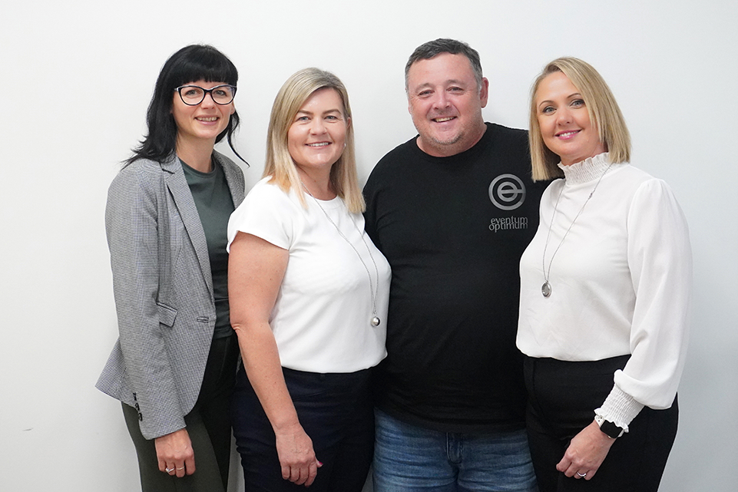

ATO Debt – the current Landscape
- ATO “reportable” o/s debt - $55BN, $34BN small business
- June 2019 - $26.5BN, doubled in 5 years
- Covid – hold on collection actions
- Insolvencies up 36% year on year to previous high – 2012
- Construction makes up largest sector (3,000 in last 12mths), followed by retail and now a more broad cross section
- ATO has ramped up collection action
- Honeymoon for small business is over
The EO Team

Slide 3

ATO Actions
The ATO can employ numerous collection strategies and these are the most common:
Financial Stability: By protecting assets, clients can maintain financial stability and continue operations even during challenging times.
  DPN’s – between July 22-July 24, over 30,000 DPN’s issued. The rate of issue has now increased even further.
  Credit Bureau Reporting Notification – no payment plan and debt over $100,000. This started as discretionary and now signals further action. This has a major impact on companies.
  Garnishee Notices – on debtors and bank accounts.
  Creditors Statutory Demands – 21 days and where creditor believes no dispute in relation to debt owed.
  External Debt Collection Agencies
  Wind up orders, judgement debts
  Chasing Directors personally for co. debts

Slide 4

Actions to Prevent ATO Debt
Communicate regularly with ATO.
Lodge Activity statements and tax returns on time, or no later than 3 months from the due date.
Enter into and maintain payment plans.
If a payment plan not granted (e.g. capacity to pay), steps to prevent business wind up:
1. SBRP (Small Business Restructure Program)
2. Voluntary Administration
3. Liquidation/Restructure

Slide 5
Division 7A Loans
What are They:
  Means of taking money out of company without paying tax. Division 7A of the ITAA is a self-executing set of integrity measures designed to combat the extraction of profits from private companies in a non-taxable form.
  These loans last 7 years and require a complying loan agreement. After 7 years, they can be secured up to 25 years via property.
  If loans are forgiven, they can be treated as a dividend for income tax purposes, and therefore treated as assessable income.
  This used to be a cheap form of finance for Co. Directors. The current rate is 8.27%
  They have now become a problem and a legacy debt that cannot be overcome on co. balance sheets.

Slide 6
Strategies to overcome legacy Div 7A loans:
  Traditional – pay dividends/wages over several years – utilizing franking credits and paying minimal top up tax.
  Now Div 7A loans are too large, cannot be cash flowed and years of declaring dividends to repay has compounded amounts outstanding.
  Greater steps and action by Directors and their Accountants are required.
  More ruthless declaration of wages and dividends
  Use of existing legislation to manage - SBRP.
  Insolvency – with asset protection implemented first.

Slide 7



SBRP Case Study
Actions
A wage was declared of $90,000 to clear outstanding Div 7A loan. This resulted in a PAYG increase of $65,000 and SG of $16,500.
The balance sheet was tidied up and then a SBR Plan submitted. The ATO, as the only creditor, accepted an offer of 15c in the dollar, repayable interest free over a period of two years.
SME Owner with ATO Debts of $200,000
  ATO Debt $200,000 (Superannuation Up to date)
  Division 7A Loan $90,000
  SG Debt of $60,000 (All their own)
The Solution
A Small Business Restructure.
The client received relief from legacy debt.
They met the criteria - A company or corporate trust, debts less than $1M and superannuation paid up to date (other than their own).

Slide 8

KEY TAKEAWAYS
Book in a session with Rod
Register for your free E-book “Solutions to Div 7A Loans”
For a confidential and empathetic conversation, reach out via: sage@eventumoptimum.com.au

