Slide 1






Slide 2
LightYear Group
Update

Slide 3
LightYear Group Update
New Zealand
LightYear Docs
  New Company & Workflow Process
    ABN + TFN Registrations
    Domain Names
    Trademarks
LightYear Training Group
  New Trainers
    Crypto, SMSF Audit, & more
    Sales & Marketing including sales & marketing partner solution
    Pinnacle Growth Packages
LY Legal & Legal Back Office
  Client Meetings, Client Events – Book them in!
  LBO Account managers
New Partnerships

Slide 4
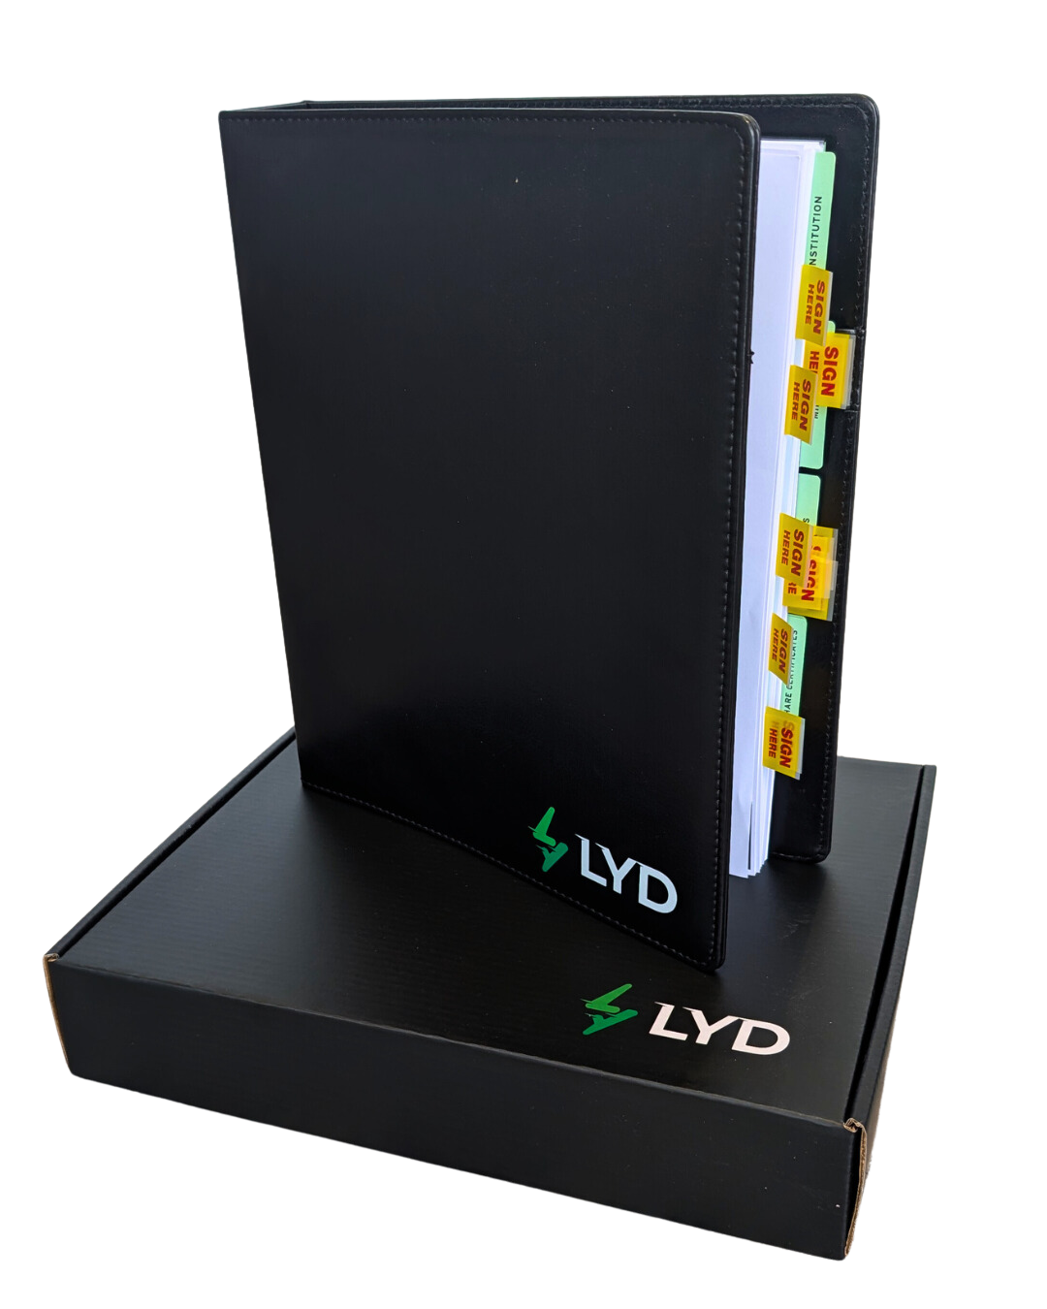

HARD COPY
SERVICE

Slide 5

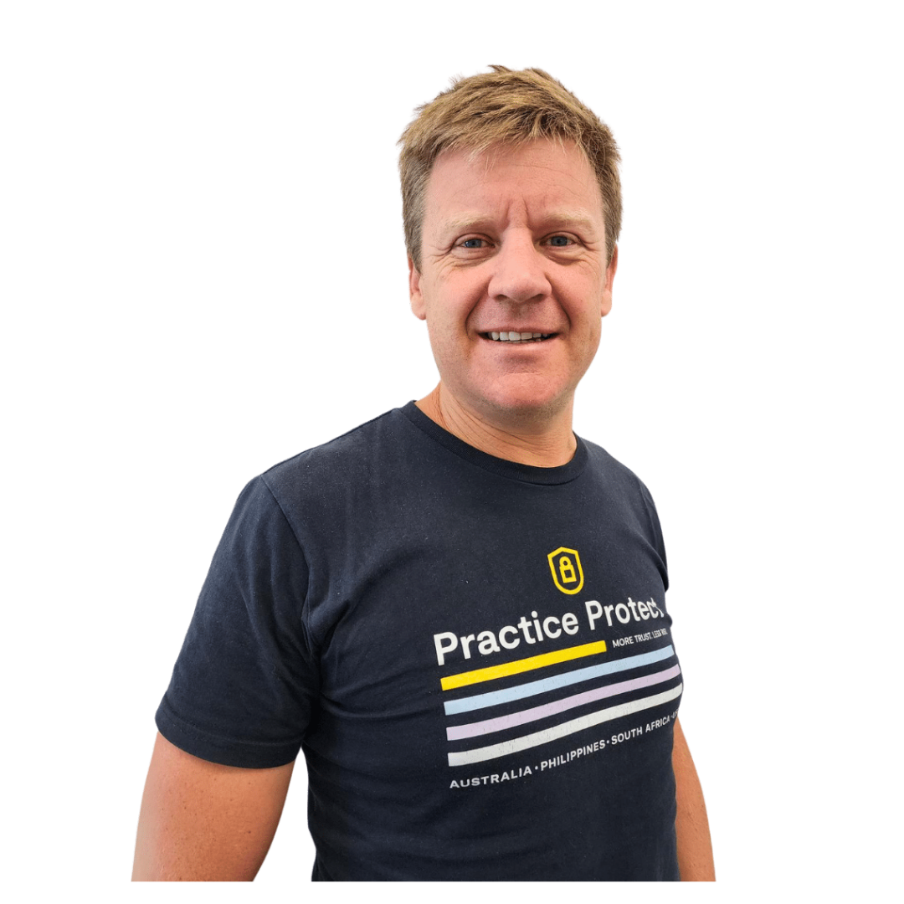
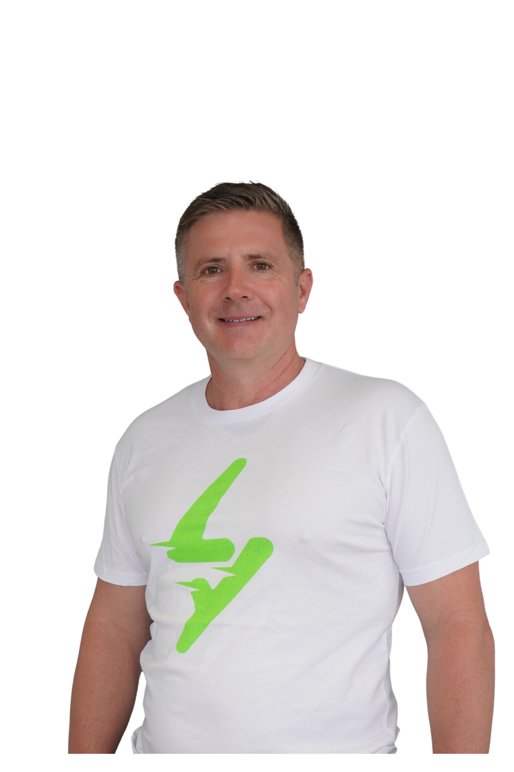
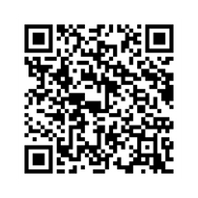

CYBER SECURITY
FOR ACCOUNTING FIRMS
REGISTER
WITH JAMIE BERESFORD
MICHAEL JEFFRIESS

Slide 6


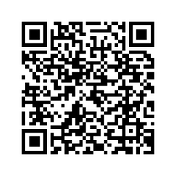
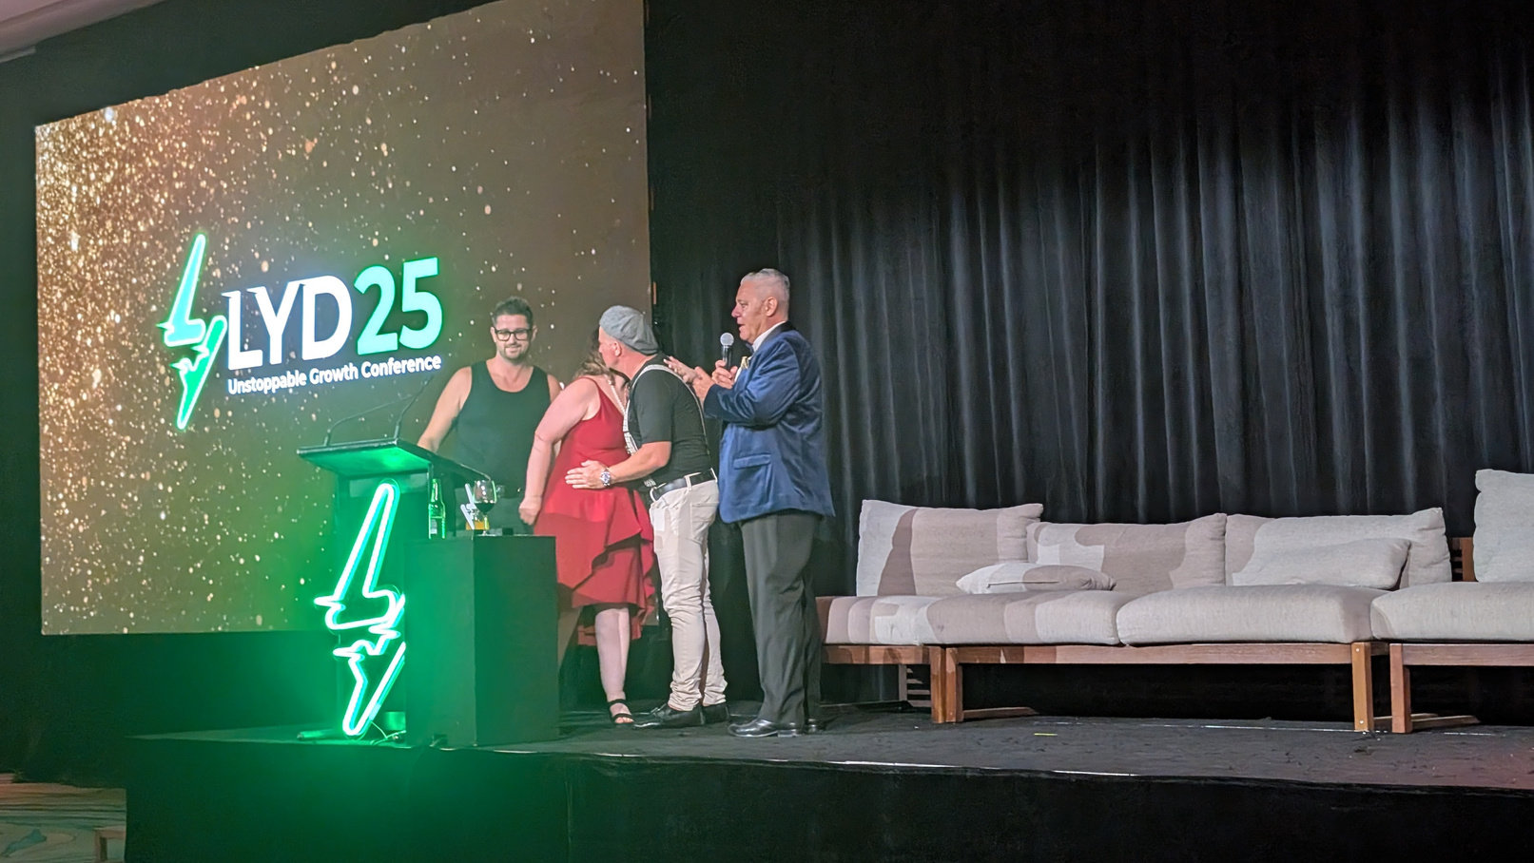
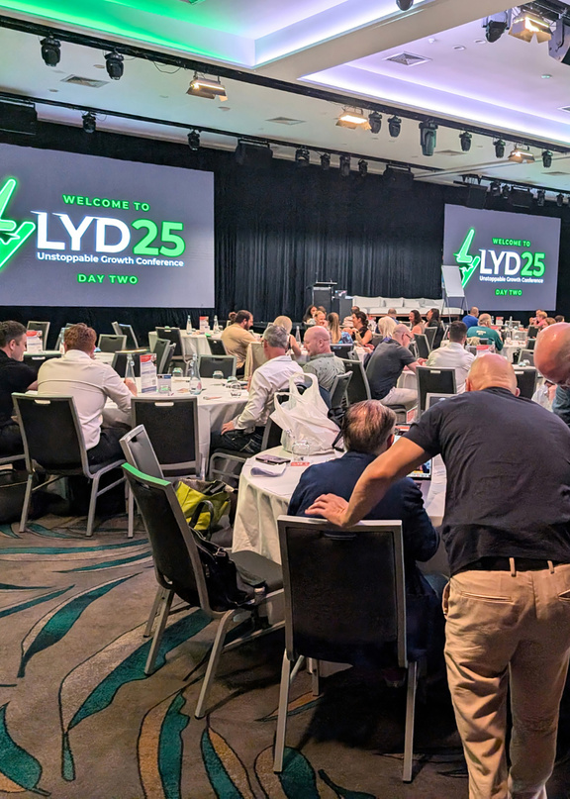
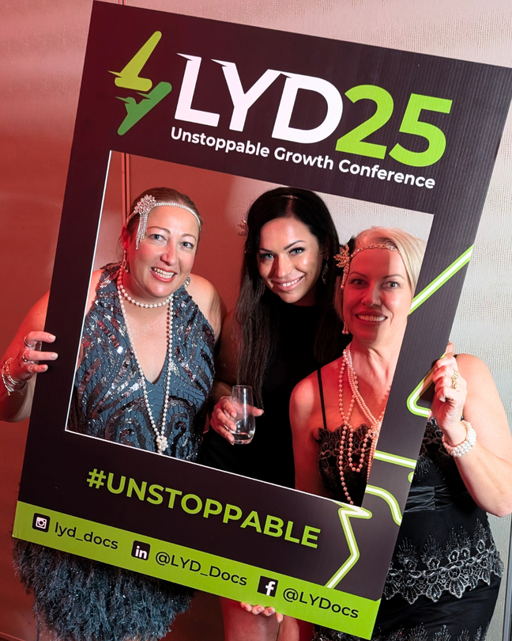
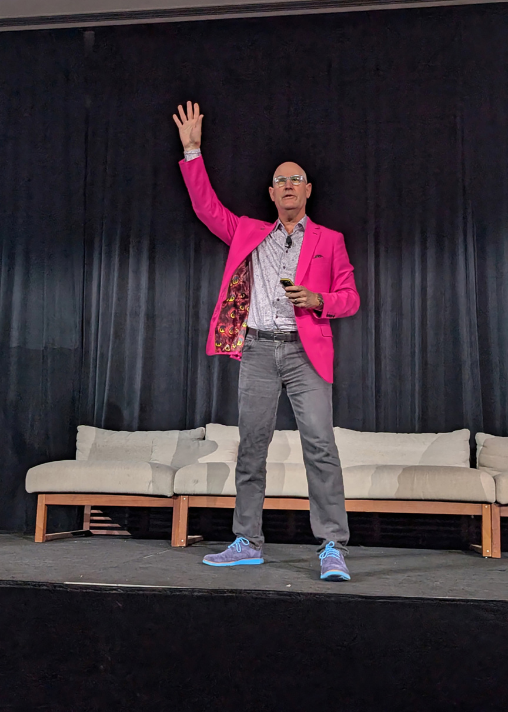
26
Unstoppable Growth Conference
GET YOUR TICKET

Slide 7



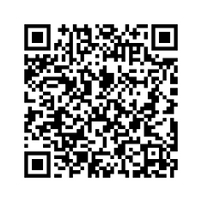
FIJI
2025
2025
GET YOUR TICKET

Slide 8
LYG PARTNER INVESTMENT OPPORTUNITIES

Slide 9
DISCLAIMER
Important Information & General Advice Warning
The content of this webinar is provided for information purposes only and does not constitute personal or general financial product advice. It has been prepared without taking into account your objectives, financial situation or needs. Before acting on any information presented, you should consider whether it is appropriate for your circumstances and seek independent, licensed professional advice.
Partner Investment Offers
Any investment opportunities discussed today are offers of our external partners, not of the webinar hosts. We do not endorse, recommend or guarantee any product, service or return described. You will be dealing directly with the relevant partner if you choose to pursue an offer, and you should obtain and read all relevant disclosure documents (e.g., Product Disclosure Statement, Information Memorandum) before making an investment decision.

Slide 10
DISCLAIMER
No AFSL Reliance / Limited Scope
The presenters are not acting under an Australian Financial Services Licence (AFSL) in providing this material (or, if an AFSL is held, the information is provided strictly as general advice only). Nothing in this session should be interpreted as a solicitation to buy or sell any financial product or as a recommendation regarding any specific investment.
Past Performance & Forward‑Looking Statements
Past performance is not a reliable indicator of future results. Any forward‑looking statements, forecasts or estimates are provided as opinions only and are subject to risks, uncertainties and assumptions that could cause actual outcomes to differ materially.
No Liability
The hosts, their employees and agents accept no liability for any loss or damage (including, without limitation, indirect or consequential loss) arising out of or in connection with the information provided or any investment made as a result of attending this webinar.

Slide 11


Slide 12


Meet Emil Juresic
Founder of NGU Property Group & NGU Real Estate
Over 20 years experience in Queensland property market and property development
Completed over $300 million in residential developments
NGU Real Estate has over 12 offices and facilitated over $1 billion in annual transactions.
Renowned for his his innovation, marketing excellence, architectural vision, relentless attention to detail and an
extensive understanding of both construction and development.

Slide 13

NGU Property Fund
Raising up to $20 million
Open exclusively to wholesale investors with a minimum commitment of $250,000, with $100,000 payable on application.
28% IRR over the investment term.
  The Fund aims to provide investors with an income return of 8% per annum, paid monthly in arrears, along with an additional distribution equal to 50% of the development profit (post-tax) for a Project payable upon completion of the Project.
South-East Queensland residential developments
Closing now……….. OPPORTUNITY ENDING

Slide 14
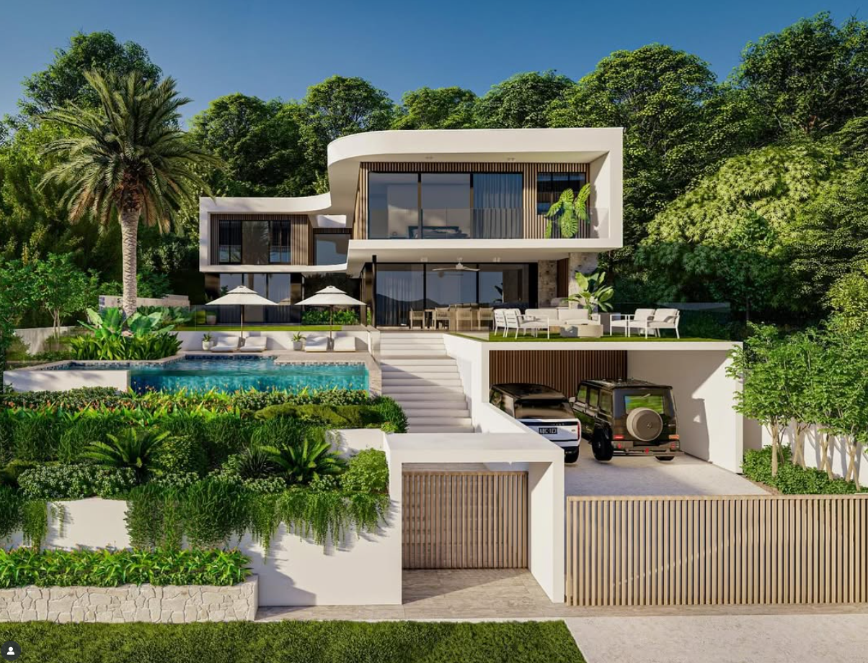
NEVERA
10 Marston Avenue, Indooroopilly
Land Size: 845m²
Estimated End Value: $12 million
A bold architectural statement of power and elegance. Spanning 825m² across three sculptural levels, NEVERA redefines modern prestige. Every line whispers intent — where serenity meets strength.
🛏️ 6 Bedrooms
🛁 7 Bathrooms
🏠 4 Living Zones
🧘‍♂️ Private Wellness Centre
💼 Executive Study
🔥 Sun drenched indoor-outdoor living spaces
🚘 11-Car Gallery Garage
🏊‍♂️ Wet-Edge Pool
NEVERA is more than a home. It’s a presence in motion.

Slide 15


VILLA ST TROPEZ – 4 Bal Harbour, Broadbeach Waters
Land Size: 1,004m²
Estimated End Value: $15 million
A new era of coastal luxury is set to unfold on 75 metres of ultra-rare canal water frontage. VILLA ST TROPEZ is a statement residence, crafted for those who demand the extraordinary.
🛏️ 5 Bedrooms
🛁 6 Bathrooms
🏠 Multiple Living Zones
🧘‍♂️ Private Wellness Centre
🍷 Bespoke Wine Cellar
🔥 Rooftop Entertainment Terrace
🚘 4-Car Garage
🏊‍♂️ Resort-Style Pool
🌊 75m of Canal Waterfront
From its sculptural form to its world-class amenities — this isn’t just a home. It’s a statement!

Slide 16

49 Toorak Street, Hamilton
Land Size: 741m²
Estimated End Value: $15 million
Set on one of Brisbane’s most elite streets, this architectural showpiece offers a rare fusion of sophistication, scale and location.
🛏️ 5 Bedrooms
🛁 5 Bathrooms
💪 Private Gym & Wellness Retreat
🚘 6-Car Garage in Brisbane City
🏛️ Bold Facade
An unrivalled street presence make this residence a defining statement in elevated urban living.

Slide 17
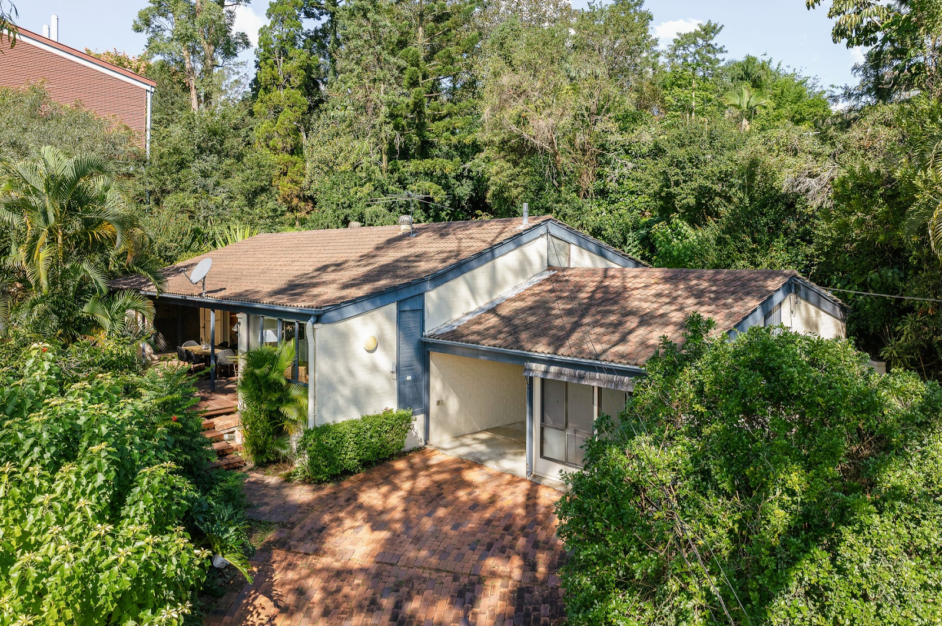
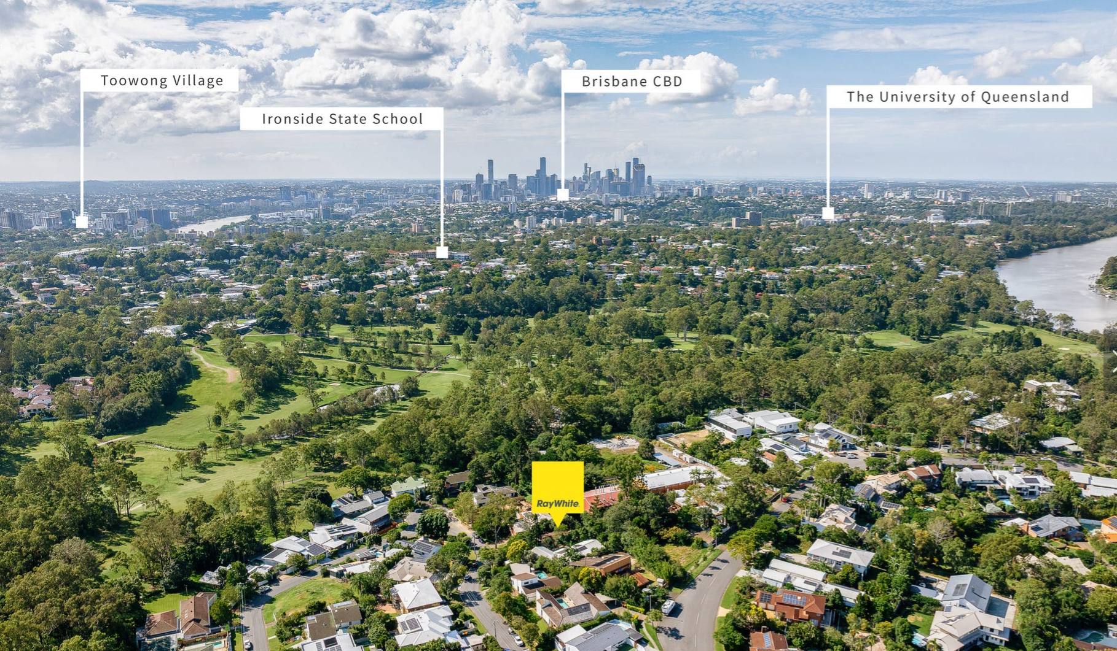
17 Cadiz Street, Indooroopilly
Land Size: 607m²
Estimated End Value: $2.5 million (on-sale) or $8 million (developed)
Purchase Price: $1.82 million
Acquired for $1.82 million with demolition scheduled for August, this parcel is already valued at $2.5 million. The fund holds two strategic options: realise an immediate capital gain through on-sale, or proceed with a high-end residential development targeting an $8 million end value.
Located in one of Indooroopilly's best streets between two golf courses and a near perfect northern aspect to capture summer breezes and the winter sun.

Slide 18
Q & A
NGU Property Fund

Slide 19


Slide 20

COMPANY DETAILS
Company Name |  | Ai Tax Guru Pty Ltd
ACN |  | 683 410 282
Offer Type |  | Small Scale Offer
Offer Details |  | SAFE Notes that convert at 20% discount to ordinary shares
Minimum Investment Amount per Investor |  | $25,000
Maximum Target Subscription |  | $750,000¹
Offer Date |  | 16th June 2025
Offer Closing Date |  | 30th September 2025
Registered Office |  | Level 3 Suite A1, Building 1 209 Robina Town Centre Drive Robina Qld 4226
¹ The Board reserves the right to increase should a strategic shareholder
provide additional capital.

Slide 21
Section 2:
About Tax Guru AI

Slide 22

THE PROBLEM
Tax research is broken!
Time Consuming – Research
Hours wasted on manual research across rulings, legislation, and case law.
Fragmented Information
No central source – requires navigating multiple databases & interpretations.
Human Bottlenecks
Senior advisors overloaded – can't scale efficiently.
Notes:
Three examples (from three different app idea) were shared to give you a better idea on how to write a good summary of the problem.

Slide 23
THE PROBLEM
Tax research is broken!
Undervalued Output
Advice often informal & unbilled – missed revenue opportunity
Risk of Errors
Inconsistent quality; risk of outdated or incorrect advice.
Time Consuming – Training
Hours spent on CPD Training to try to keep up to date with latest legislation and rulings.
Notes:
Three examples (from three different app idea) were shared to give you a better idea on how to write a good summary of the problem.

Slide 24



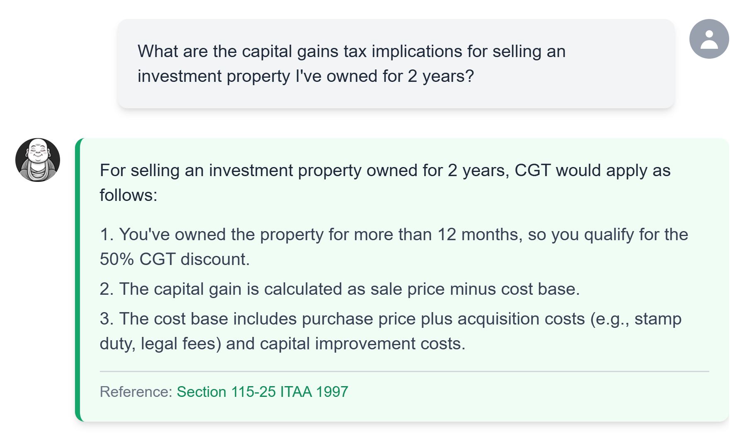
OUR SOLUTION
Tax Guru AI
AI-Powered Tax Research & Advice
✅ Custom-trained LLM on AU tax legislation and rulings
✅ Prompt-based research – Instant answers
✅ Generates advice papers & emails ready for clients
✅ Reviewed by advisors to ensure compliance
✅ Secure closed system – not reliant on public models
Notes:
Three examples (from three different app idea) were shared to give you a better idea on how to write a good summary of the problem.

Slide 25




OUR SOLUTION
Frontend
Infrastructure
AU-Specific
Tax LLM
AU Tax
Experts
Qualified tax experts review & fine-tune responses for ongoing accuracy and compliance
Tax Legislation
Tax Research
Review Feedback Loop
Tax Strategy
Notes:
Three examples (from three different app idea) were shared to give you a better idea on how to write a good summary of the problem.

Slide 26
OUR SOLUTION
Tax Guru AI
AI-Powered Tax Research & Advice
✅ Custom-trained LLM on AU tax legislation and rulings
✅ Prompt-based research – Instant answers
✅ Generates advice papers & emails ready for clients
✅ Reviewed by advisors to ensure compliance
✅ Secure closed system – not reliant on public models
Notes:
Three examples (from three different app idea) were shared to give you a better idea on how to write a good summary of the problem.

Slide 27
OUR SOLUTION
Australia’s AI Tax helpers. Making tax research and client advise work feel like a breeze.
Specific AI Agents for Tax Modules
SMSF
Trusts
General Tax LLM
Div 7A
International Tax
✅ Alpha Testing Completed
✅ Beta Testing (Stage 1) about to kick off
GST
CGT
In development for Release 2.
More modules to come.
Notes:
Three examples (from three different app idea) were shared to give you a better idea on how to write a good summary of the problem.

Slide 28



OUR SOLUTION
Master of super strategies and
compliance across the
SMSF universe.
Including Grant Abbott’s
SMSF research material &
strategies
Secret-keeper of private company loans and Division 7A traps.
Notes:
Three examples (from three different app idea) were shared to give you a better idea on how to write a good summary of the problem.

Slide 29


OUR SOLUTION
The cross-border commander of multi-jurisdictional compliance and treaties.
Protector of credits, destroyer of ATO errors—GST doesn’t stand a chance.
Notes:
Three examples (from three different app idea) were shared to give you a better idea on how to write a good summary of the problem.

Slide 30


OUR SOLUTION
The cross-border commander of multi-jurisdictional compliance and treaties.
Saves the day when assets are sold—wielding rollover relief like a weapon.
Notes:
Three examples (from three different app idea) were shared to give you a better idea on how to write a good summary of the problem.

Slide 31

WHY NOW
Seizing the Moment: The Tax Guru AI Advantage
Perfect Timing for Disruption
Trend | 💥 Impact
ATO Compliance Push | Documentation & justification now essential for all tax advice
AI Adoption in Accounting Firms | Firms are actively exploring efficiency-boosting tech
Talent Shortages | Senior tax talent is scarce – AI extends capacity
Monetisation of Advice | Firms want to convert knowledge into billable, structured output
Tech-Driven Advice Revolution | From compliance → advice → automation
Notes:
Three examples (from three different app idea) were shared to give you a better idea on how to write a good summary of the problem.

Slide 32
MARKET SIZE
$500m + Spend
TAM
Total Addressable Market
Annual spend on tax research, advice, and documentation.
>150,000 qualified professionals
SAM
$250m to $300m Spend
Service Addressable Market
~40,000–50,000 users across ~8,000–10,000 firms
SOM
$50m to $60m
Serviceable Obtainable market
Target spend in first 3–5 years
Top 5,000 firms (~15,000–20,000 users)
Notes:
Three examples (from three different app idea) were shared to give you a better idea on how to write a good summary of the problem.

Slide 33
COMPETITION
🧠 Competitor | ⚠️ Limitation
Thomson Reuters / CCH | Expensive, non-AI, manual outputs
ChatGPT / Gemini | Generalist models, no AU tax data, high risk of incorrect advice
Tax Software AI Assistants / Compliance & Practice Management Products | Basic help only, not advice-oriented
Internal Knowledge Bases | Inconsistent, non-scalable, manual
✅ Tax Guru AI is the only purpose-built, AI-driven, advice-ready tax LLM in Australia.
Notes:
Three examples (from three different app idea) were shared to give you a better idea on how to write a good summary of the problem.

Slide 34
BUSINESS MODEL
Subscription Fees
Subscription-based SaaS (monthly/annual)
Indicative pricing will be $20 per month (starter) through to $149 per month (unlimited)
Add-ons:
Custom advice templates, white-labelling, firm-wide reporting tools.
Additional specific tax area agents such as SMSF, CGT, etc.
Partnerships
Industry tech apps partner with Tax Guru to provide to members, provide API Access, & custom models
Future opportunity
Other Tax Jurisdictions
Roll out to other jurisdictions starting with NZ
Notes:
Three examples (from three different app idea) were shared to give you a better idea on how to write a good summary of the problem.

Slide 35
BUSINESS MODEL
💳 Model | 🔍 Details
Pricing Tiers | Solo, Small Firm, Enterprise Plans
Billing Options | Monthly or Annual – per seat pricing
ARPU Estimate | $20–$149 per user/month
Stickiness Factors | Workflow integration, compliance reliance, billable output
Expansion Potential | Add-ons: white-labelling, integrations (XPM, FYI Docs, etc.)
New Markets | Other international jurisdictions
📌 Revenue Predictability + High Retention = Long-Term Value
Notes:
Three examples (from three different app idea) were shared to give you a better idea on how to write a good summary of the problem.

Slide 36


MARKET ADOPTION
Partnerships
Initial partnerships with LightYear Group and SAPEPAA
Audience size of over 1,500 active member firms
Awareness
First users found
Feedback gathered – Alpha Testing
Beta Testing about to commence
Over 250 enquiries from accounting firms wanting to be a part of Beta Testing phase.
Advertising in SBATTA Facebook Group which has over 10,000 accountants gained significant interest in the product.
Notes:
Three examples (from three different app idea) were shared to give you a better idea on how to write a good summary of the problem.

Slide 37
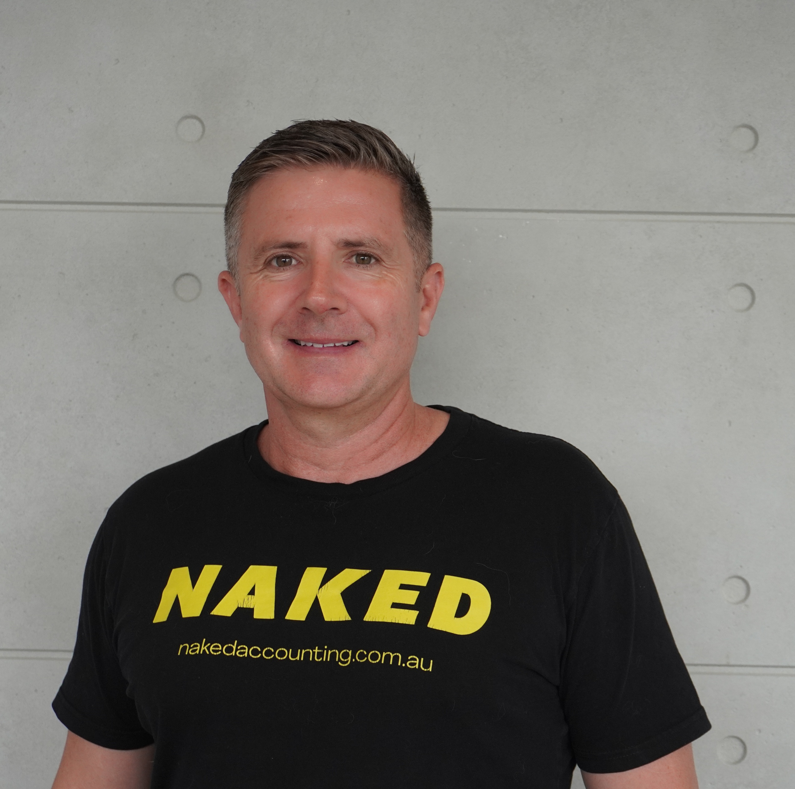

THE TEAM
Michael Jeffries
Grant Abbott
CEO & Co-Founder
Michael is a fellow chartered accountant with a broad range of experience in executive and director roles across a number of both ASX listed and privately held Groups. He is director and Group CEO of We Love Group and Naked Accounting (2023 Australian Accounting Firm of the Year), director and secretary of Succession Asset Protection Estate Planning Advisers Association and director, company secretary, chair remuneration, nomination & audit committee at LightYear Group Limited, LightYear Docs Pty Ltd and LightYear Training Group Pty Ltd.
CSO & Co-Founder
Grant has a Masters of Laws specialising in tax and superannuation law. He has been at the forefront of self-managed super fund thinking since 1994, and is a driving force in the succession, asset protection and estate planning sector. Grant Abbott is the key trainer for LightYear Group. He is also director and lead consultant to Legal Back Office.
He founded LightYear Docs, Now Infinity, and SMSF Strategist Group.
Notes:
Three examples (from three different app idea) were shared to give you a better idea on how to write a good summary of the problem.

Slide 38

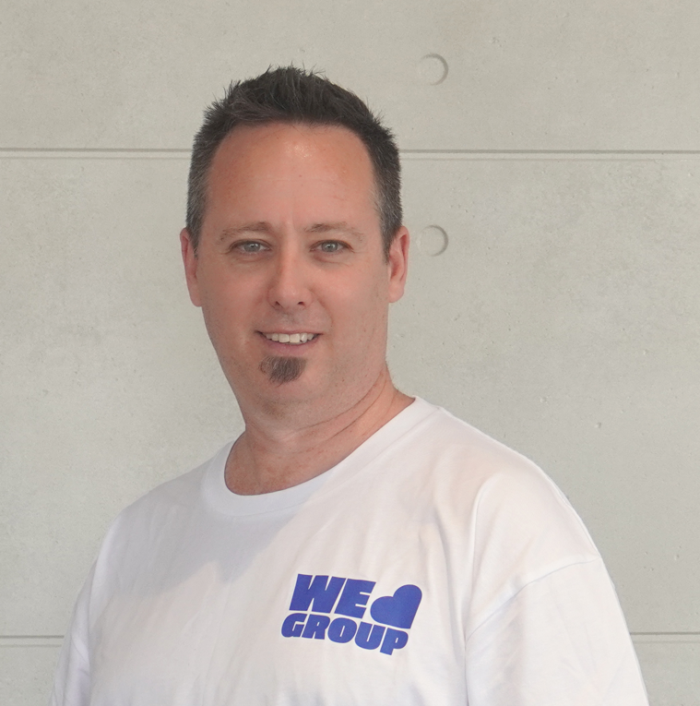
THE TEAM – Industry Experts
William Burns
Brett Levy
CTO
Computer Science undergraduate at Griffith University, double majoring in Data Science and AI, and Algorithms and Computing. Alongside his studies, he runs AutomateWise, an AI Automation Agency where Will specialises in AI consulting & developing AI-driven solutions for businesses.
CMO
Brett Levy is an experienced marketing and digital engagement specialist with over two decades in brand, tech, and media. Currently CMO at Red Oxygen and Head of Marketing at We Love Marketing, he blends strategic insight with creative execution across digital platforms.
Notes:
Three examples (from three different app idea) were shared to give you a better idea on how to write a good summary of the problem.

Slide 39
OUR ASK
Invest in Tax Guru AI's Vision
Join us in transforming how tax advice is researched, delivered, and monetised.
Invest in Tax Guru AI and be part of the next evolution in professional services — where AI turns hours of technical research into billable, client-ready advice in seconds.
Together, let’s empower accountants and advisors with the tools they need to scale, comply, and deliver more value than ever before.
Minimum Investment $25k
Includes discounted foundation Tax Guru membership
Contact us: connect@tax-guru.ai
Notes:
Three examples (from three different app idea) were shared to give you a better idea on how to write a good summary of the problem.

Slide 40
USE OF FUNDS
$750k
AUD
$275k
$75k
$400k
People
Marketing
Technology + Product
Sales + Sales Support
Tech engineers
Tax advisors – legal & accounting
Brand
Websites
Paid advertising
SEO
Events / Sponsorship
Company Process
AI Project
Notes:
Three examples (from three different app idea) were shared to give you a better idea on how to write a good summary of the problem.

Slide 41

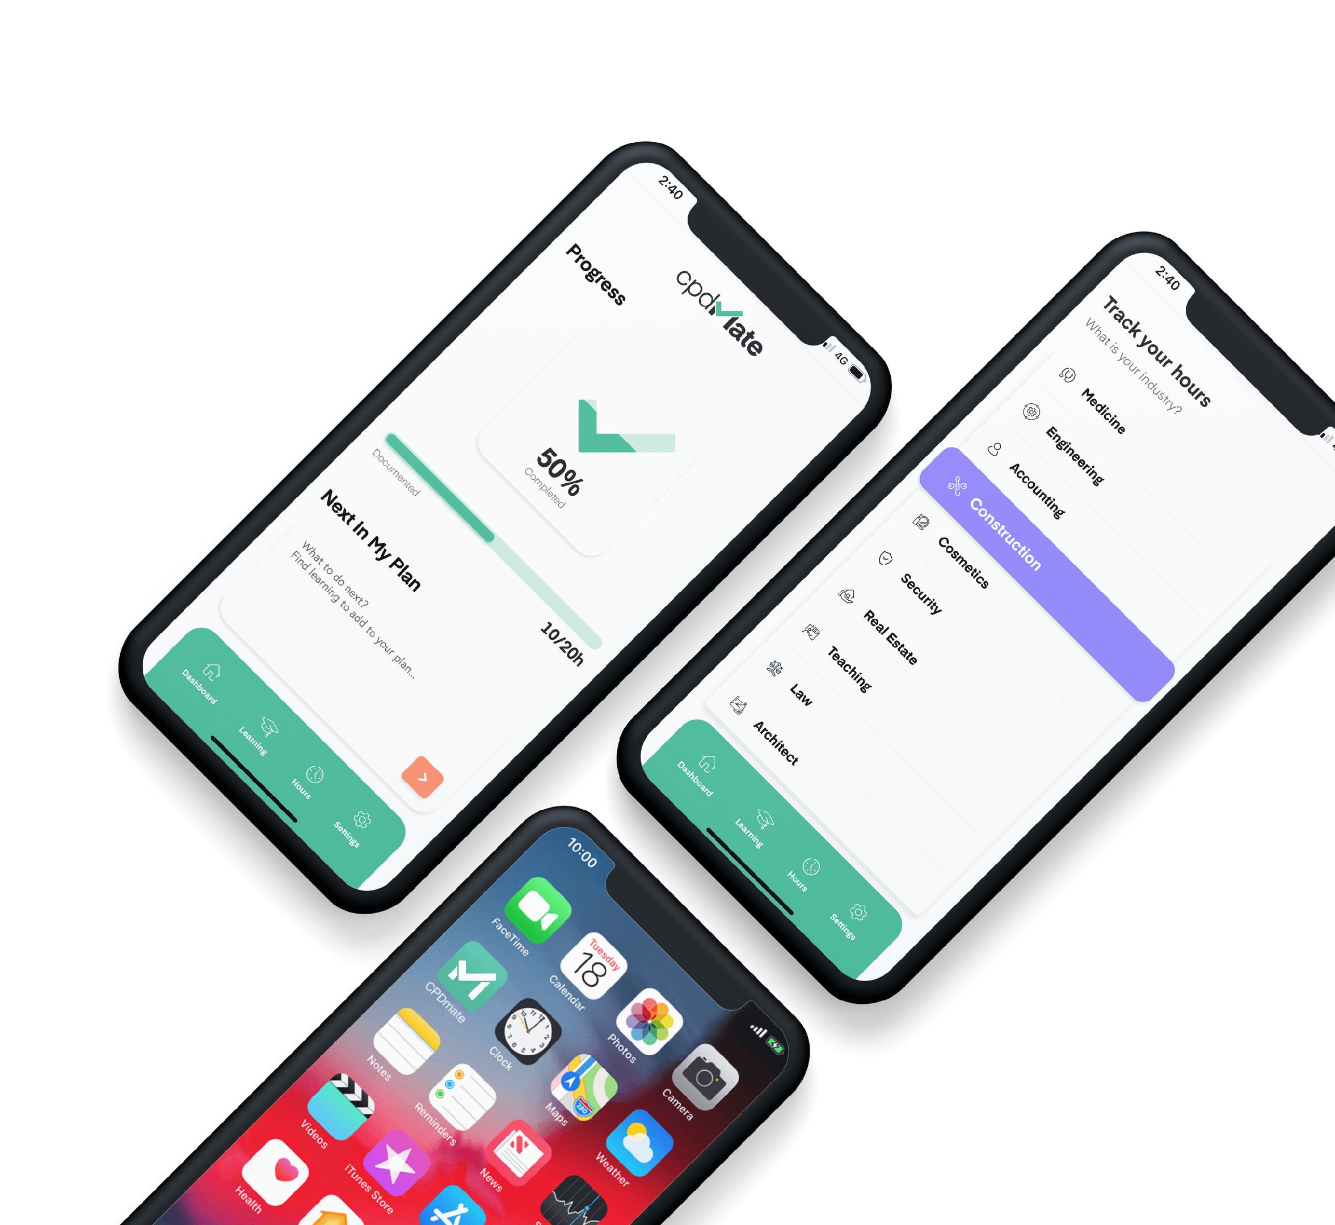

CPD Mate
An app to simplify, collate and track Continued Professional Development (CPD)

Slide 42

CPD: Developing Australia’s professionals!
Consumers rely on professionals to be up to date with the newest education, practices, processes and industry knowledge.
Government legislation requires professionals to continue their professional learning and track that learning as CPD points.
This protects consumers, and ensures every professional is highly-educated and at the forefront of their industry.

Slide 43
CPD:
Developing Australia’s professionals!
cpdmate.app
CPD assists professionals to:
Build the knowledge and skills needed to succeed in a competitive professional environment
Achieve personal development and career goals Excel in their role, creating value for the organisation and its clients or customers
Enhance their transferable skills, thereby increasing employability
Engage with the profession and the wider community
•
•
•
•

Slide 44

Industries that benefit from CPD include:

Slide 45
Professionals can accumulate points by completing:
Informal work related CPD
Formal CPD
Ways to accumulate points include:
Approved activities that contribute to your CPD

Slide 46

The problem:
Managing CPD can be quite confusing and overwhelming for professionals while working
day-to-day.
CPD is widely viewed as an obligation, not a beneficial means to improve a professional career, employment prospects or abilities.

Slide 47

Until now, it has been their responsibility to:
•
Work out their own industry specific CPD education plan
Find applicable education and activity modules Keep evidence of completing education modules Track and maintain their own professional development portfolio
Ensure all modules are completed and submitted on time
•
•
•
•

Slide 48
The market size:
With over 195,800 accountants practicing in Australia alone, across all industries, we estimate the potential customer base to be in excess of 4 million professionals.

Slide 49

The solution:
CPD Mate is an app that changes, and simplifies the way professionals manage their CPD.
Our goal is to have learning viewed more positively, as planning a career progression and finding, comparing and tracking points will be highly simplified and user friendly.

Slide 50



The CPD Mate APP
We are developing an all inclusive CPD Management app that will be available on both the Apple & Android App Stores.

Slide 51
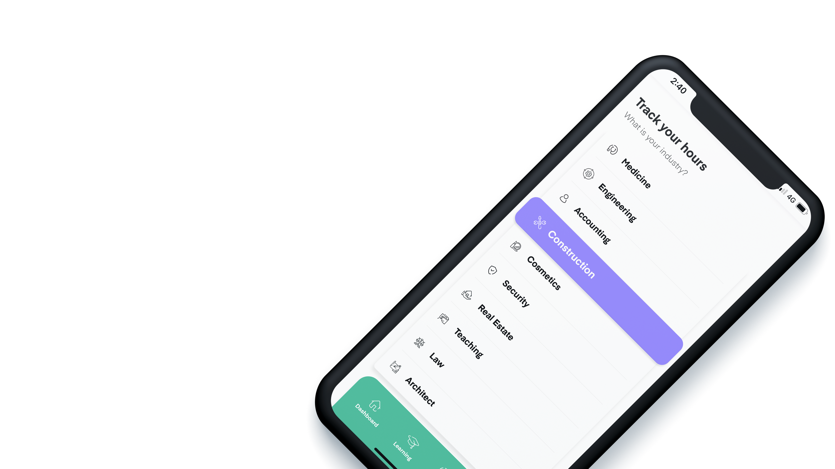
Any Industry
Unlike competitors, the app will have educational modules for ALL CPD relevant industries.

Slide 52
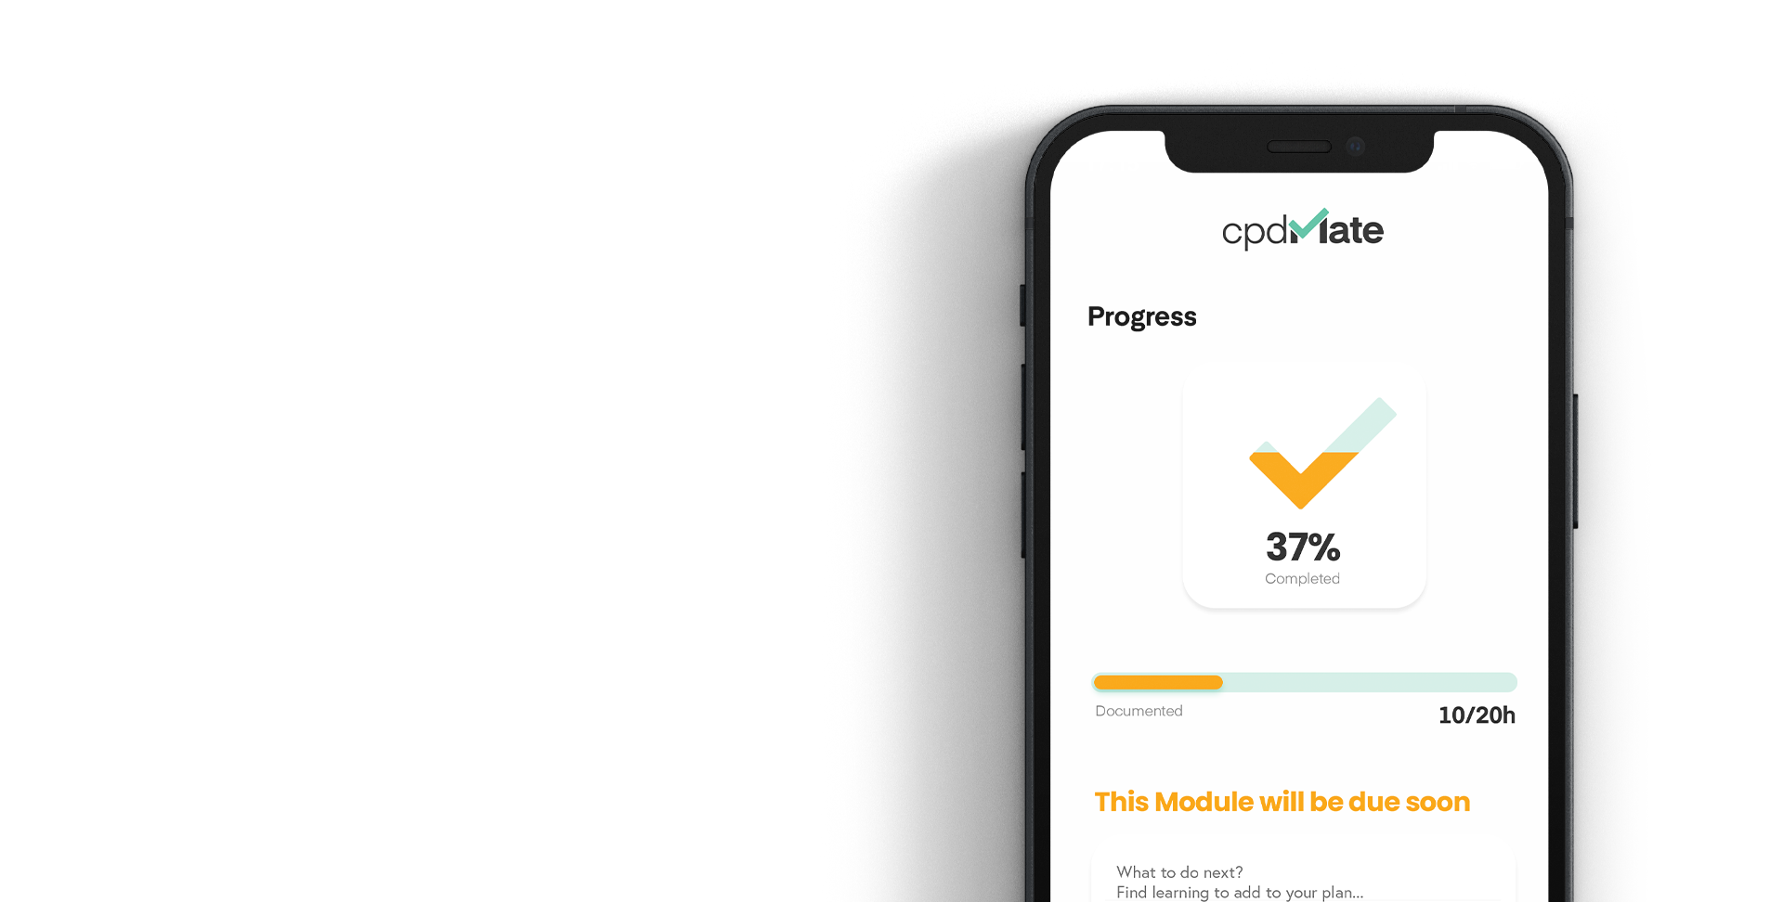
Planned Career Development
Users will be able to create and customise a CPD plan, with the app tracking their progress and alerting them of overdue modules.

Slide 53
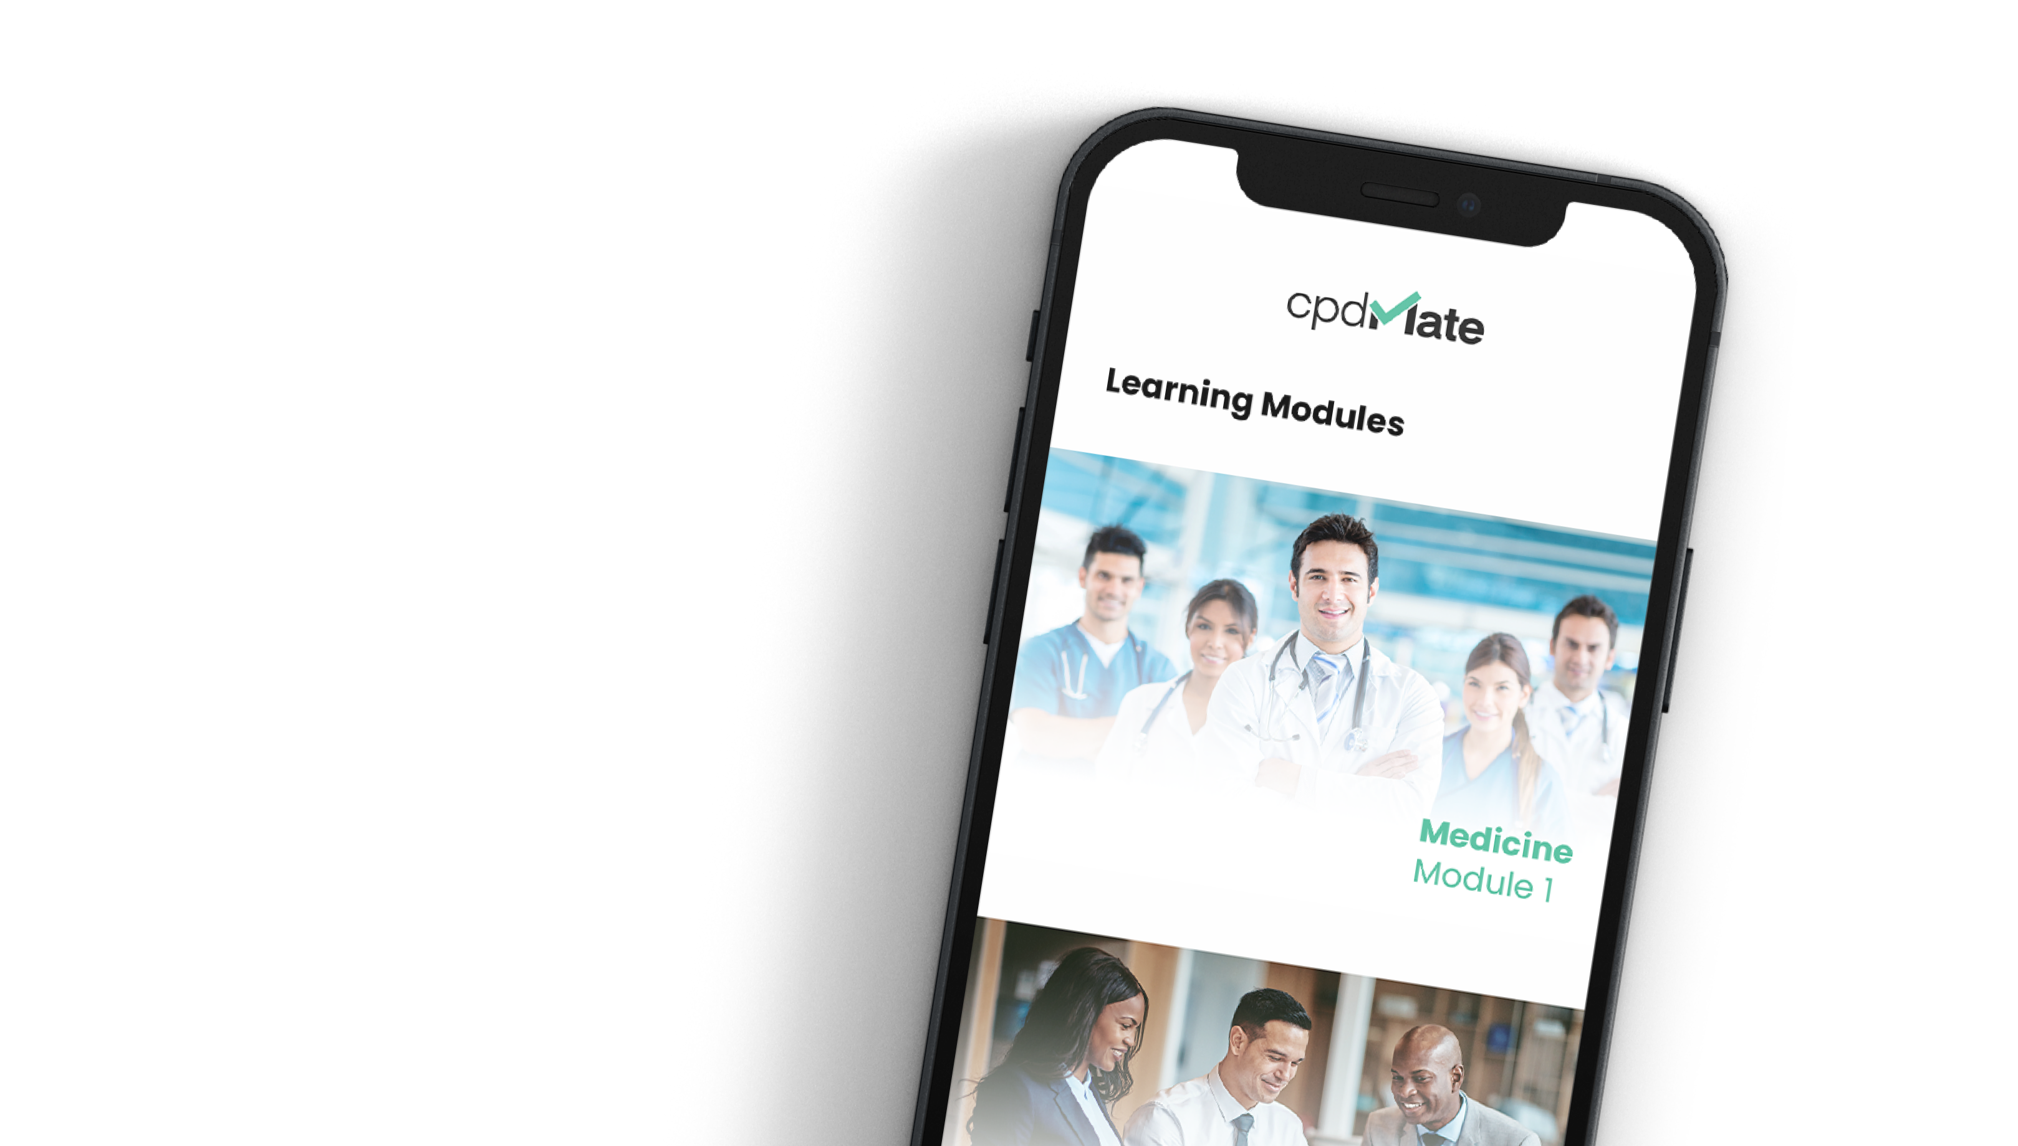
Quality Education
Major universities and education institutions will provide ongoing learning and career development modules.

Slide 54

Automated Tracking
Every CPD point will be automatically tracked within the app, ensuring professionals never fall behind on their obligations.

Slide 55

Business Model
Software as a Service (SAAS)
We have chosen a SAAS model for the following reasons:
SAAS models maximises customer retention
SAAS model provides affordable recurring payments
SAAS model provides predictable cashflow for continued improvements

Slide 56

Our proposed billing model:
Freemium plan.
Free app download, and the allowance for limited use of the app services for free.
Monthly plan.
Users will pay a fixed $12/month for the continued use of the service.
Yearly plan.
Users get a 20% discount by subscribing yearly. Total $115.20 (Save $28.80)

Slide 57


Roadmap:
Pre-seed Funding - Complete Company Branding - Complete Website V1 - Complete
IP Protection - In Progress
Series A Funding App Wireframes Website V2
App Development Go to Market Marketing
Series B Funding

Slide 58

Offer Details

Slide 59

Contact:
Michael Jeffriess
0417 770 044 | michael@lyd.com.au
Ben Gill
0437 838 400| ben@lyd.com.au
cpdmate.app

