Slide 1

LYD Strategy Solution Series
"The Good Trust”
The Family Protection Trust
Change your way of thinking – Now before it is too late!

Slide 2

DISCLAIMER
The information provided during this webinar is for general information only.​​
​​
It should not be taken as constituting professional advice from LightYear Docs, Abbott & Mourly or any of our related brands.​​
​​
We are not a financial advisers. You should consider seeking independent legal, financial, taxation or other advice to check how the information provided in this webinar suits yours and your clients needs. Abbott & Mourly can provide specific advice in these areas covered. Please contact Tony Anamourlis on tanamourlis@abbottmourly.com.au or contact LightYear Docs support for a referral after the webinar. ​​
​​
LightYear Docs and Abbott & Mourly are not liable for any loss caused, whether due to negligence or otherwise arising from the use of, or reliance on, the information provided directly or indirectly, by way of this webinar. ​

Slide 3

The Problem – Family Wealth Protection
The Solution – The Family Protection Trust
For many Australian and for that matter worldwide families, wealth protection through asset protection and succession planning is one of the most important things to a family.
With the preponderance of family assets in individual or joint names, family wealth is exposed. Even for those families that have put their assets into their “risk free” spouse's name or into a trust, family wealth is still exposed with these strategies post Bosanac.
With serious economic headwinds blowing post pandemic lock downs and measures, we MUST protect our client’s family wealth not only for their own generation but for bloodline generations to come. The best protection is the Family Protection Trust – a must for the $6,000 Bn or $6Tn of wealth at jeopardy now! It is time to move.

Slide 4

  Australia has the highest per capita number of lawyers in the world
  Lawyers and Courts have adopted to a post Covid world
  Negligence, occupational health and safety, ASIC, ATO, Fair Work, building accident – who isn’t exposed to a damages or loss claim?
  We can see what is coming but why the “deer in the headlights” – has Covid numbed all of our senses?
LITIGATION
EXPOSED

Slide 5
  Assets, investments, companies, trusts and even super funds are exposed where a key person, director or trustee is in the throes of insolvency or bankruptcy
  Section 120 of the BA 1961 provides that the Trustee in Bankruptcy can apply to the Court to void an undervalued transaction
  The key issue is the solvency of the person at the time of the undervalued transaction
  Will a trustee in bankruptcy take action three years out?
  The best time to do it is now!!! And your clients know it. The big question is how are you protected personally – and your family!!!!
BANKRUPTCY
EXPOSED

Slide 6
  Covid should have burnt deep into the mind of everyone that hospitalisation can be moments away
  Where a person suffers from mental incapacity then they cannot be a trustee or director of a company.
  How many of the 2.5 million companies do not have an “incapacity plan” in place? Especially for sole directors for trading, bucket, discretionary trust or SMSF trustee companies.
  What happens to the shares and assets of incapacitated clients – is there an enduring power of attorney to even deal with banks and governments
  The best time to do it is yesterday!!! And do it for all family members over age 18.
INCAPACITY
EXPOSED

Slide 7
  On death most people who have a Will would expect that all of their personal assets, including home, investments and superannuation would be paid out in accordance with their Will. Wrong!!!
  Every State in Australia allows a disaffected person (someone who did not benefit from a Will or get what they believe they deserved) to claim against an estate. Any claim overrides the provisions of a Will.
  A Real Case in Point: A family provision claim on estate assets may result in long and costly court proceedings. In Western Australia in 2018 the judge of the WA Supreme Court castigated lawyers who had taken five years and $500,000 in legal fees to challenge a $600,000 estate consisting only of the deceased’s home.
  Is traditional estate planning worth it if there is even a 5% or greater chance of a challenge?
ESTATE PLANNING
EXPOSED

Slide 8
  Most people are not aware that a simple de-facto relationship that has lasted two years means both parties of the relationship, in the event of a relationship breakdown, have full recourse against the other’s property under the Family Law Act in Australia
  Matrimonial property includes all assets, businesses, shares and superannuation
  Discretionary Trusts will be matrimonial property where the party to the marriage controls the trust
  Second or third generation beneficiaries that do not control the trust will not have trust matrimonial property but it will be a possible financial resource
FAMILY LAW
EXPOSED

Slide 9
  Starts with Succession planning – who is to control the Trust for generations to come. It works for the Royal Family and will for your clients.
  Only GOOD stuff goes into the Trust. You can repurpose existing discretionary trusts without resettlement but make sure they are Good!!
  Beneficiaries are limited to the controllers (Family Protection Appointors) and their bloodline. Can include spouse and non-bloodline at FPA’s discretion – permanent, fixed or casual
  Set up with jurisdiction in South Australia for longevity but stamped where Trustee is
  Build with special purpose Family Protection Trustee Company
The Family Protection Trust

Slide 10
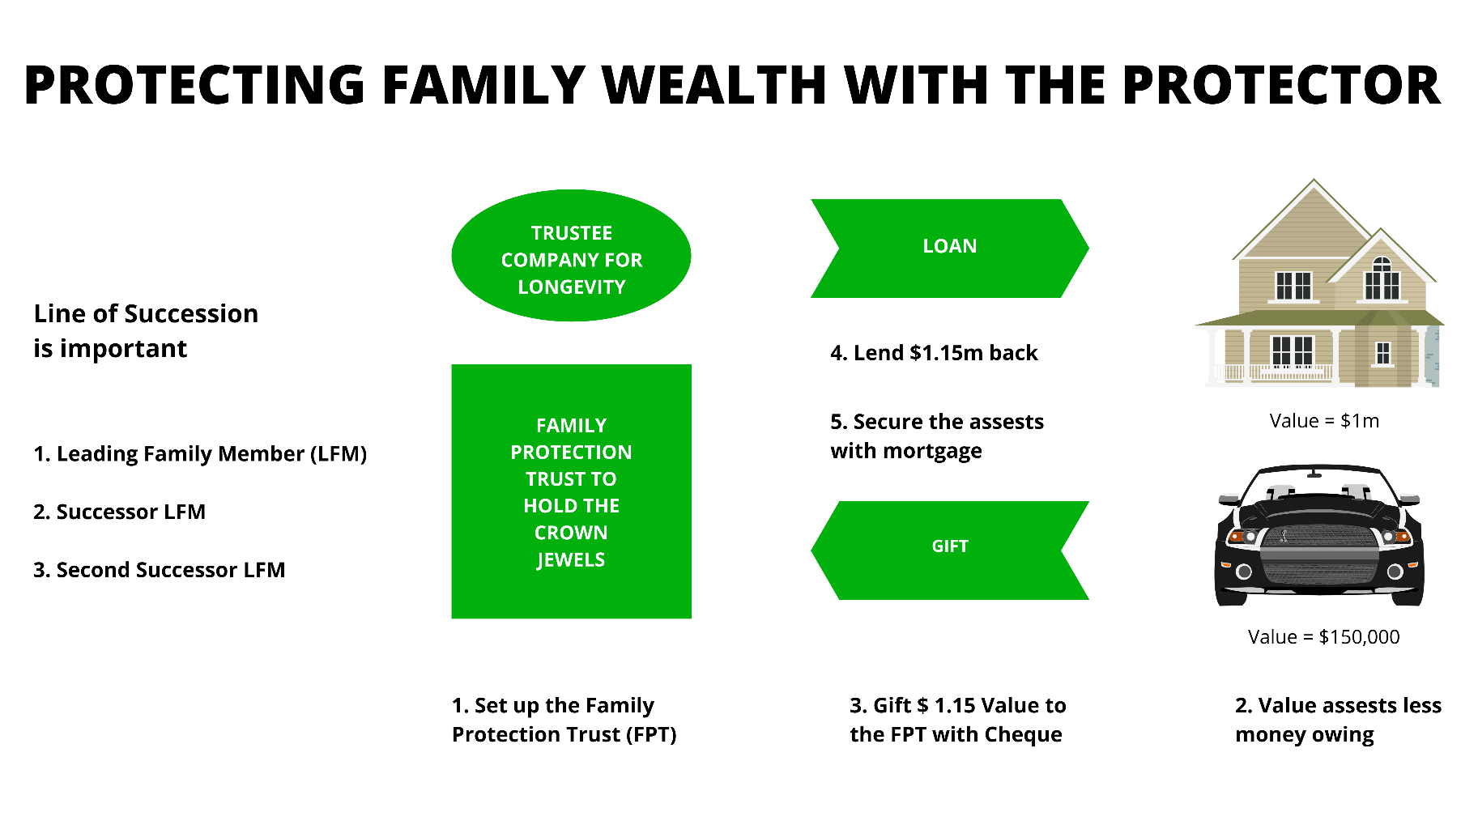
PARTNER SOLUTION SERIES SPECIAL

Slide 11

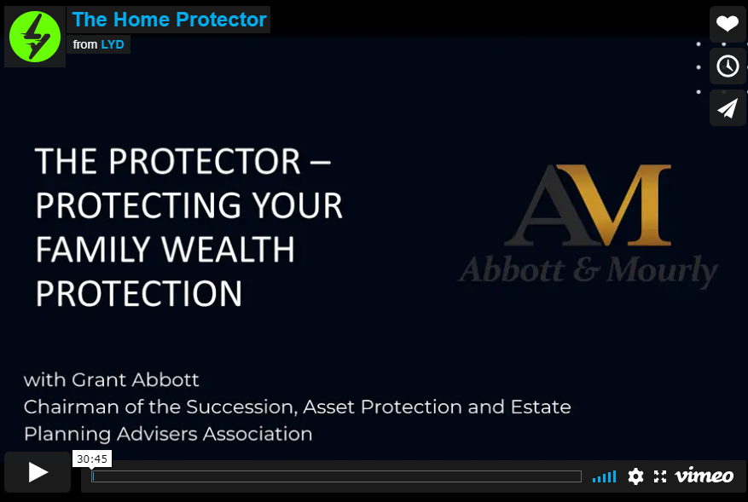
PARTNER SOLUTION SERIES SPECIAL
Client
Video

Slide 12
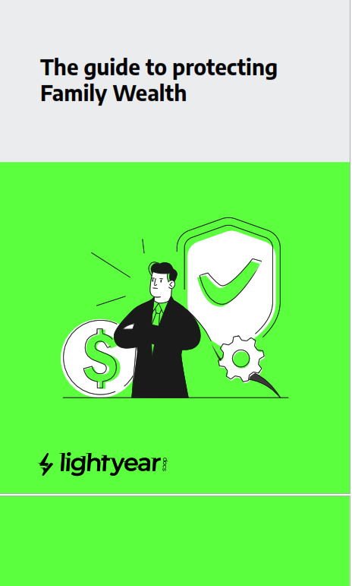
PARTNER SOLUTION SERIES SPECIAL
Client
Booklet

Slide 13



PARTNER SOLUTION SERIES SPECIAL
  Atia v Nusbaum [2011] QSC 44 – The original gift – loan back case where the Court held there was no shame because there was documentation in place
  Commissioner of Taxation v Bosanac [2021] FCAFC 158 – where the family home in the spouse’s name was able to be used to pay off ATO debts of the husband
  Re Permewan [2021] QSC 151 – family provisions claim with aggressive trustee of the trust who was also the executor – conflict of interest
  Turner v O’Bryan-Turner [2021] NSWSC 5 – gift loan back by client which fell down as no gift was completed
The Cases

Slide 14
PARTNER SOLUTION SERIES SPECIAL
  A trust can be a great vehicle, if structured properly to protect assets, a business, investments and family wealth as well as to look after bloodline lineage. However, if not structured properly, it can be a disaster in the making.
  The Protector uses a special purpose Trust for the beneficiaries of your lineage or bloodline that you desire, including yourself and your spouse. If you have an existing trust this may prove suitable unless it is also potentially openly exposed because it runs a business or service.
1. Establish a Family
Protection Trust

Slide 15
PARTNER SOLUTION SERIES SPECIAL
  To protect assets - we do not transfer the assets but only their underlying value. This is done by way of a gift as Australia does not have a gift tax. The way it works is like this. We determine the valuation of all assets in a person’s legal name which may include the family home, investment properties, cars, jewellery, private company shares, investments, unit trusts and other assets. Then we deduct any loans or borrowings on those assets to determine the new wealth or net equity that the legal owner of the assets has across their entire asset portfolio.
2. Calculate Family Wealth

Slide 16
PARTNER SOLUTION SERIES SPECIAL
  Once the net wealth or equity value in all the owner’s assets is determined this is then gifted to the Trust using a cheque like instrument called a promissory note – also known as a legal IOU. Once this is done the person gifting the net equity still owns all the assets, there is no transfer remember, but their personal wealth has been reduced to zero or a vey low number. This is where the protection comes from.
3. Gift Net Wealth to the Family Protection Trust

Slide 17
PARTNER SOLUTION SERIES SPECIAL
  If the asset owners wish to continue to use the property then the trustee of the Family Protection Trust will lend the corresponding net equity in the gifted assets back to the legal title holders of the assets (the original gifter). This is the same as what happens with a bank when you buy a home. You buy the home using borrowed monies from the bank and the bank lets you use the home provided you continue to service the loan.
4. Loan to Asset Owners

Slide 18
PARTNER SOLUTION SERIES SPECIAL
  Over time assets may increase in value which would require an on-going gift loan back of the increased value over time. An alternative is for the legal owner to offer a call option to the Trustee of the Family Protection Trust. The way it works is the Trustee and the owner enter into an option agreement where the Trustee has the ability to acquire, by way of purchase the assets for an amount equal to their market value at the time of the option.
  For example, John Smith owns a house worth $1M with a $200,000 bank mortgage. John has set up the Smith Family Protection Trust and gifted the net equity in his home - $800,000 into the Trust which has been lent back to John and secured with a second mortgage. John enters into a call option agreement with the Trustee, who pays $100 for the option to acquire the property at some time in the future for $1M. If the property goes down in value, then the Trustee loses its $100. But if the property goes up to $1.2M then the value of the option is now $200,000 (less its cost). The key element here is that the increased value has gone to the Trustee.
5. Special use of Call Option

Slide 19
PARTNER SOLUTION SERIES SPECIAL
  Just like a bank it is crucial for the trustee of the Family Protection Trust to secure the loan by registering a mortgage over all real estate. If a bank currently holds a mortgage on the property, the Trustee will hold a second mortgage and may be required by the bank to complete a Deed of Priority ensuing the bank retains first mortgage rights.
  For any personal property like shares, cars, jewelry, collectibles and other assets these can be secured through the governments Personal Property Securities Register. We have specialists that can register mortgages and lodge PPSR registration on behalf of the Trustee.
  Please note – we recommend contacting EO BEFORE you have your documents signed by your clients as they will review these for you and add any additional registration forms required.
6. Securing the Loan
- The Eventum Optimum Solution

Slide 20
PARTNER SOLUTION SERIES SPECIAL
  The Protector is an advanced and effective strategy that provides protection on multiple levels
  It is no different to insurance which is designed ot protect family wealth but a lot less costly and with no physical examinations, limits or restrictions
  The best time to do The Protector was yesterday
  Gather your clients data, complete the required documentation on LYD, then contact our partners at EO for registration. Please note – we recommend contacting EO BEFORE you have your documents signed by your clients as they will review these for you and add any additional registration forms required.
THE NEXT STEPS TO FAMILY WEALTH PROTECTION

Slide 21

Stay Connected!
www.facebook.com/LYDocs/
www.linkedin.com/company/
https://lyd2.com.au/
www.facebook.com/Eventum-Optimum
www.linkedin.com/company/eventum-optimum/
www.eventumoptimum.com.au
https://www.facebook.com/AbbottMourly
www.linkedin.com/company/abbott-mourly/
https://abbottmourly.com.au/

Slide 22
DISCLAIMER
The information provided during this webinar is for general information only.​​
​​
It should not be taken as constituting professional advice from LightYear Docs, Abbott & Mourly or any of our related brands.​​
​​
We are not a financial advisers. You should consider seeking independent legal, financial, taxation or other advice to check how the information provided in this webinar suits yours and your clients needs. Abbott & Mourly can provide specific advice in these areas covered. Please contact Tony Anamourlis on tanamourlis@abbottmourly.com.au or contact LightYear Docs support for a referral after the webinar. ​​
​​
LightYear Docs and Abbott & Mourly are not liable for any loss caused, whether due to negligence or otherwise arising from the use of, or reliance on, the information provided directly or indirectly, by way of this webinar. ​

